Slide 1
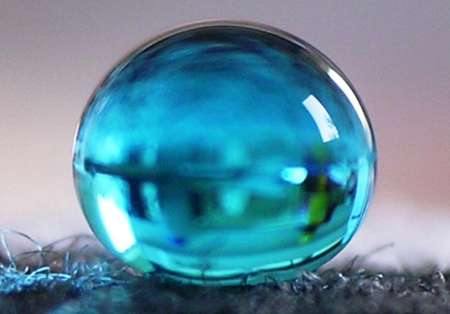
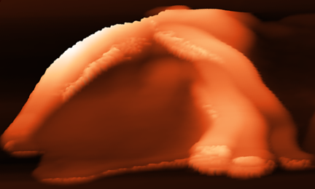
Nanotechnologies – world of small
dimensions and big opportunities
Radek Zbořil
Palacky University
RCPTM, Olomouc
„Our planet's physical, chemical, and biological processes are influenced or driven by the properties of nanoparticles.“ M. F. Hochella, Science, 2008

Slide 2
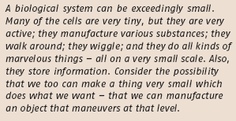
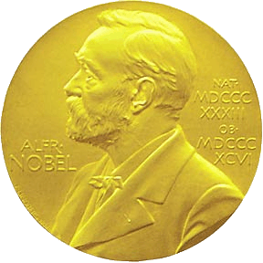
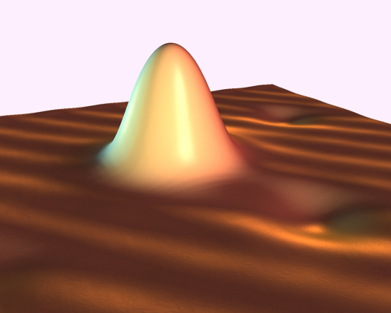
Nanohistory…
When did it start?
1959 – R. Feynmen, APS meeting, Pasadena
„There‘s Plenty of Room at the Bottom” vision of nanonotechnologies
prediction of discovery of memory chip, method of nanomanipulation
1965
1981 – scanning tunneling microscopy (STM)
possibility of 3D imaging with atomic resolution Nobel Prize - Binning, Rohrer - 1986

Slide 3
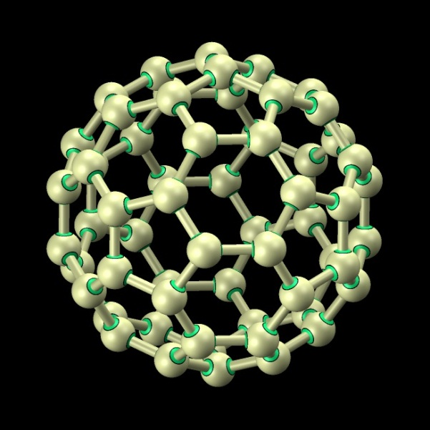
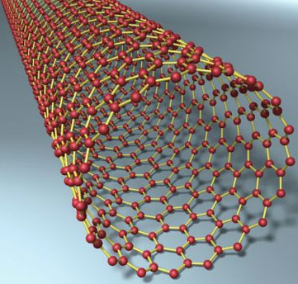
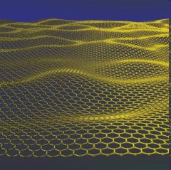
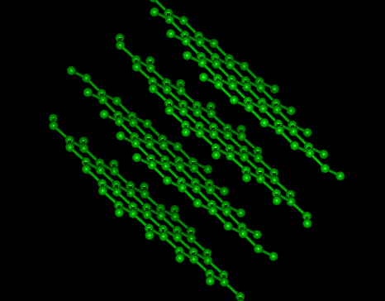
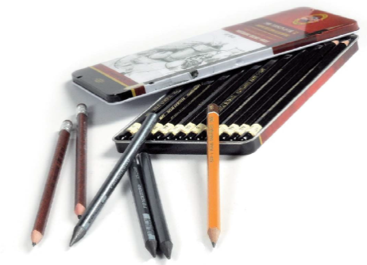
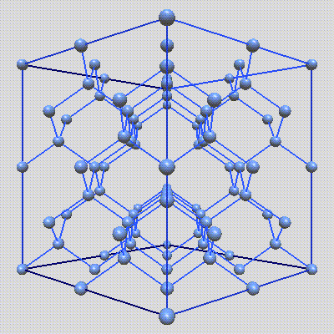
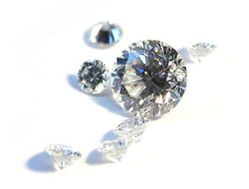

Nanohistory …
It started with carbon
0D
1D
2D
1985 – discovery of fullerene C₆₀
Nobel prize – 1996
Kroto, Smalley, Curl
1991 – nanotubes
Nature,1991
S. Iijima
2004 – discovery of graphene
Nobel prize - 2010
A. Geim, K. Novoselov
3D

Slide 4
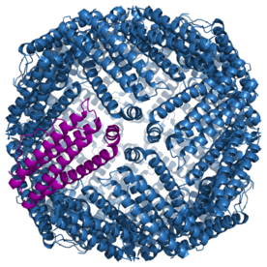
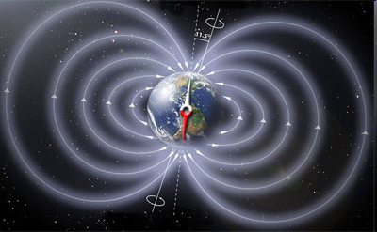
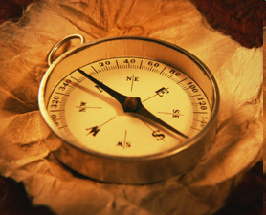
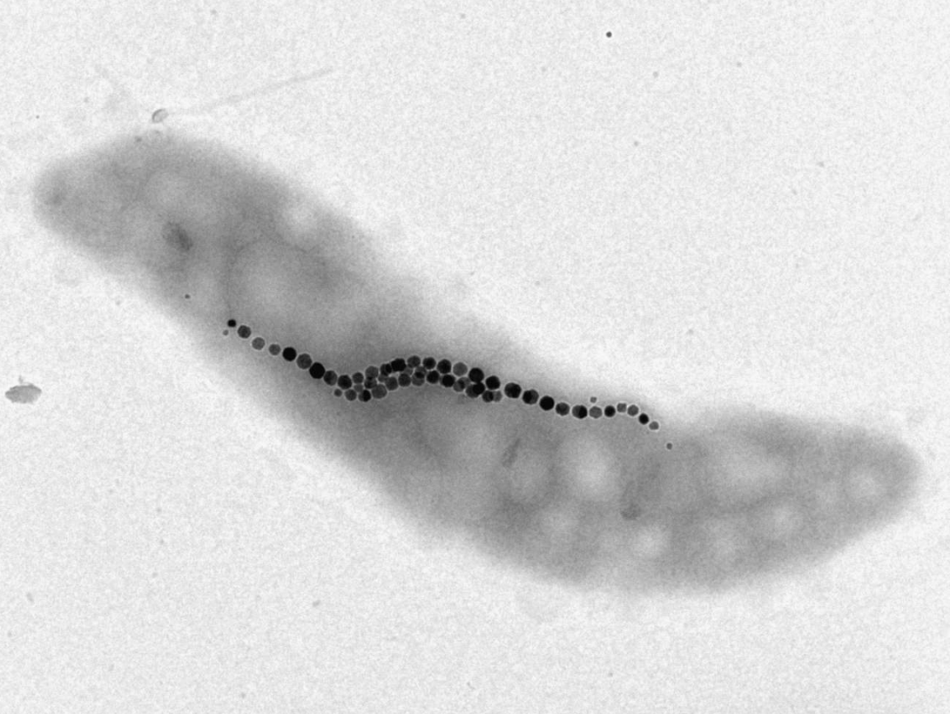
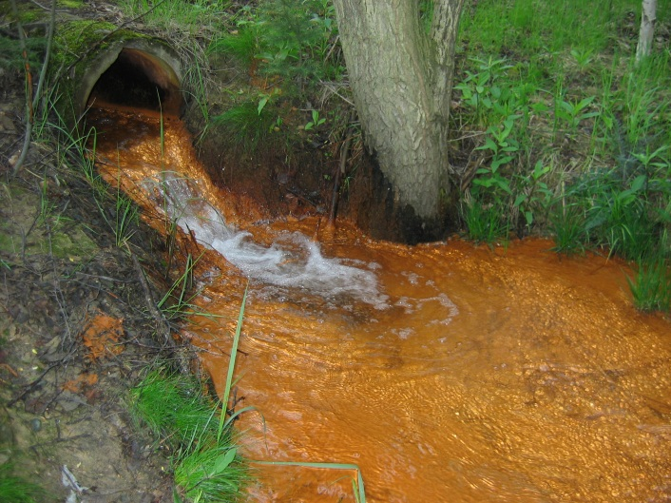
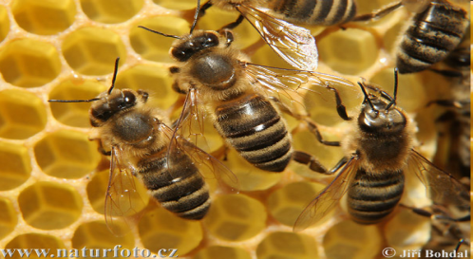
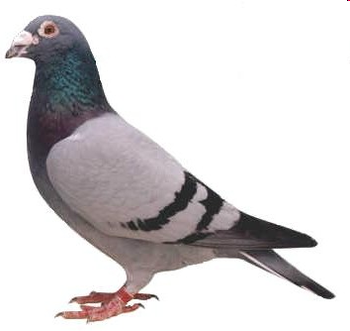
It started much earlier …
Nano-objects are all around us
in human body
in lower and higher organisms
in water

Slide 5
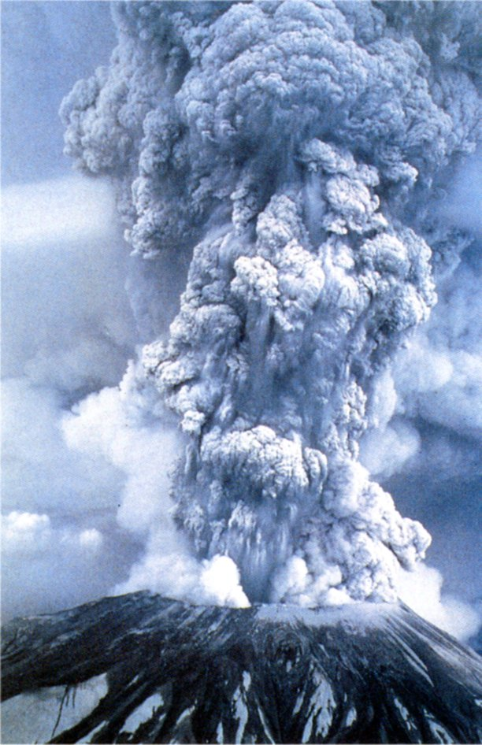
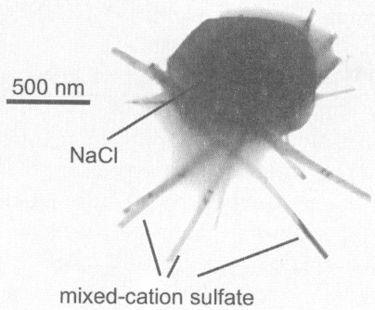
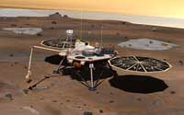
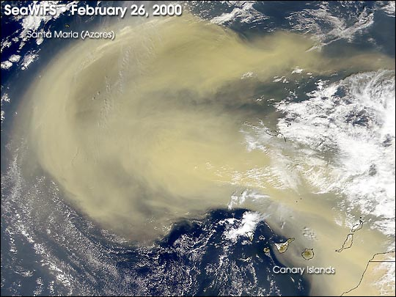
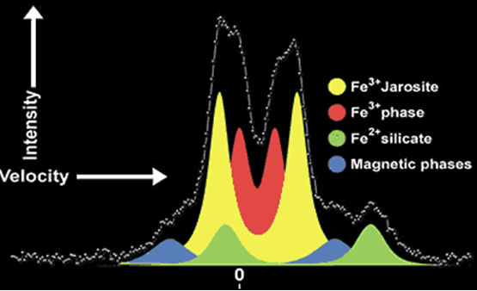
It started much earlier …
Nano-objects are all around us
in the atmosphere (volcanic activity, aerosols, wind erosion)
on Mars
G. Klingelhofer et al. Science 306 (2004) 1740.

Slide 6
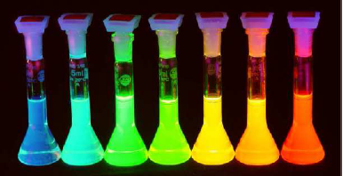
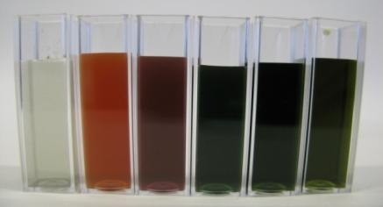
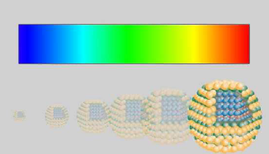
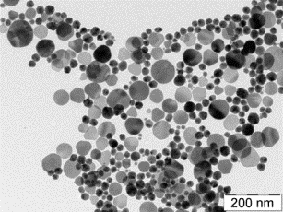
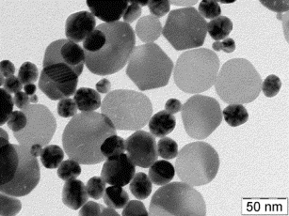
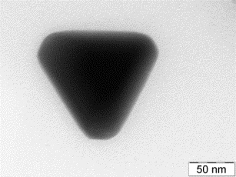
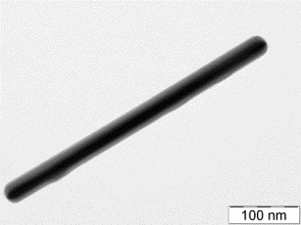
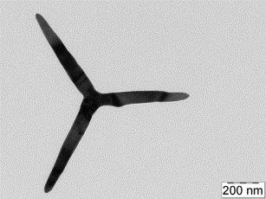
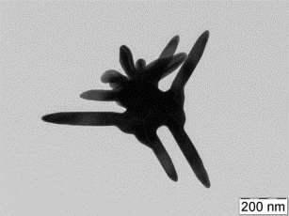
What nanoparticles can…
QUANTUM dots (CdSe)
SILVER NANOPARTICLES
FLUORESCENCE, CHANGE COLOR

Slide 7
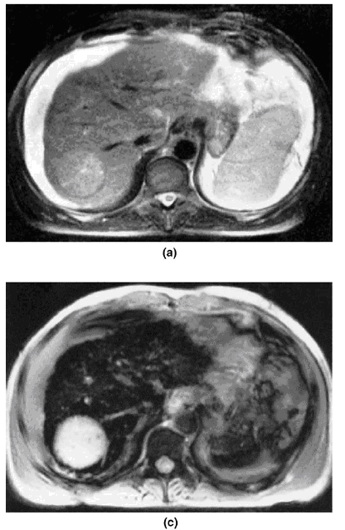
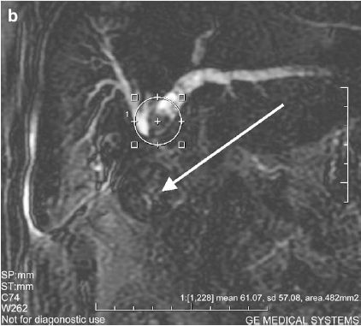
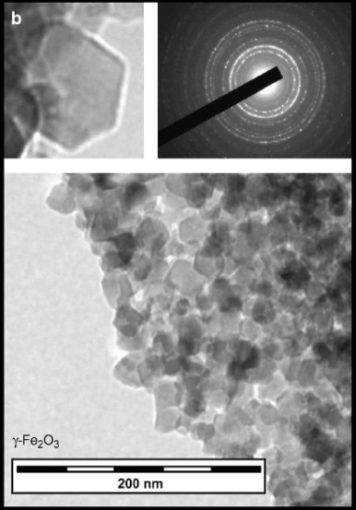
What nanoparticles can…
NANOPARTICLES AS CONTRAST AGENTS IN MRI IMAGING
DIAGNOSE

Slide 8
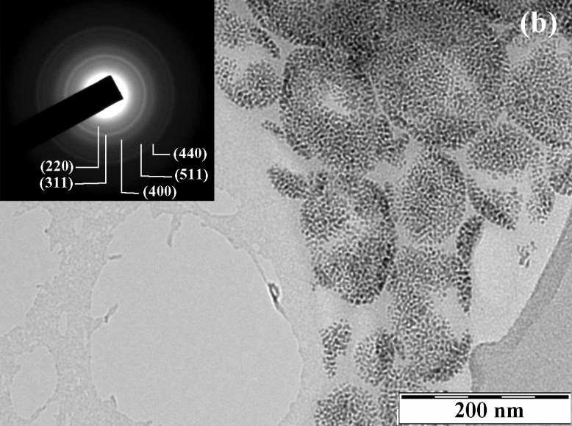
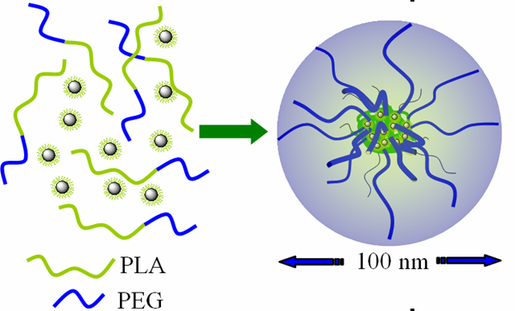
Co What nanoparticles can…
NANOPARTICLES FOR TARGETED DRUG DELIVERY AND MAGNETIC FLUID HYPERTHERMIA
TREAT

Slide 9
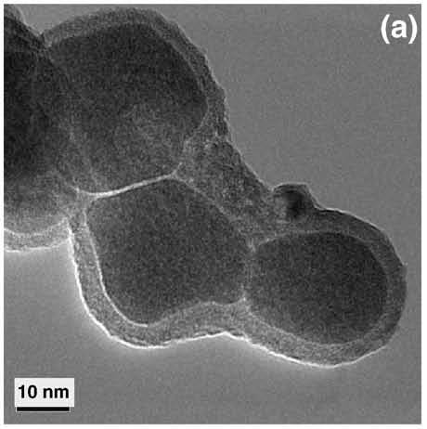
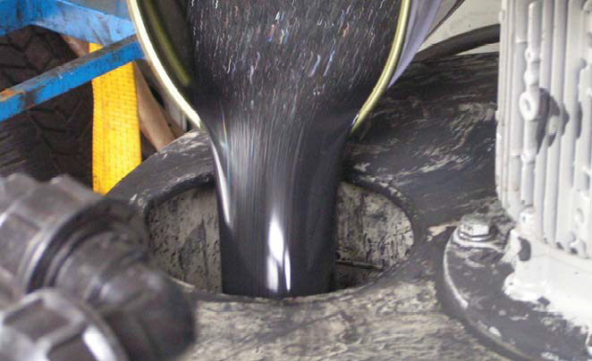
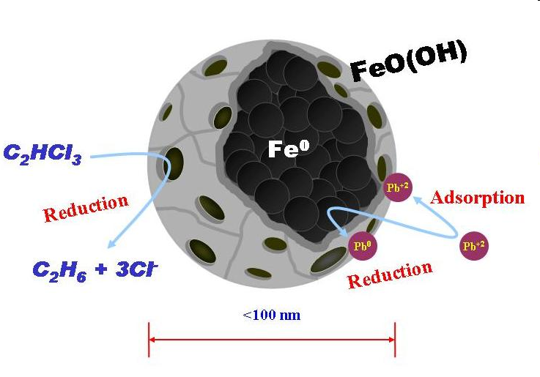
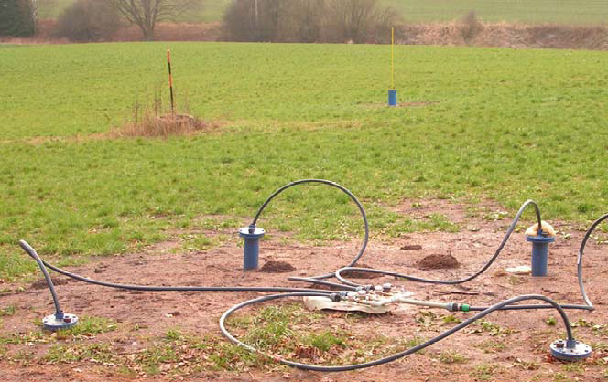
What nanoparticles can…
IRON NANOPARTICLES IN GROUNDWATER TREATMENT TECHNOLOGIES
PURIFY

Slide 10
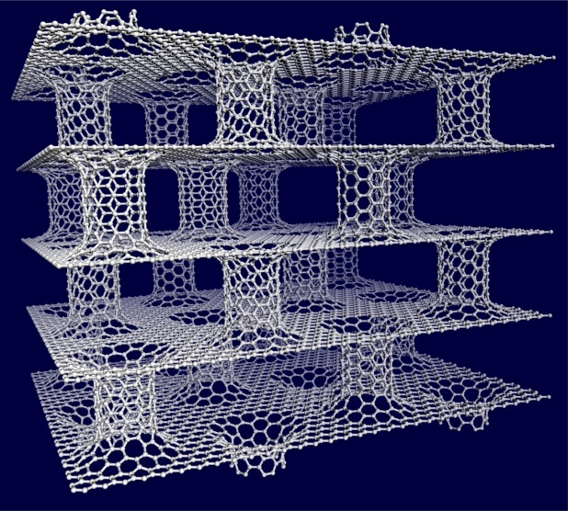
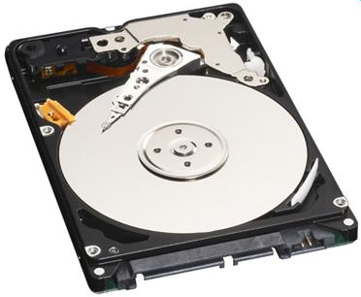


What nanoparticles can…
NANOCARBON FOR HYDROGEN STORAGE
HARD DISCS BASED ON MAGNETIC NANOPARTICLES
MRAM MEMORIES (spintronics, magnetoelectronics)
STORE

Slide 11
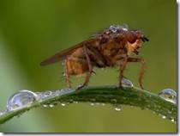

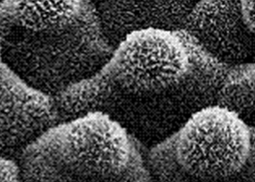

What nanoparticles can……
CARBON NANOTUBE BASED
SUPERHYDROPHOBIC COATINGS
INSPIRATION IN NATURE
(LOTOS LEAF)
PROTECT

Slide 12

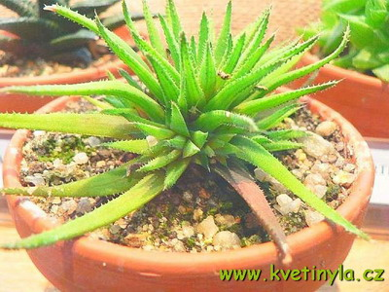
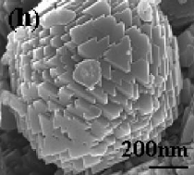
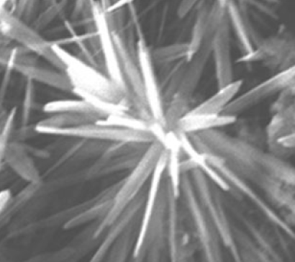
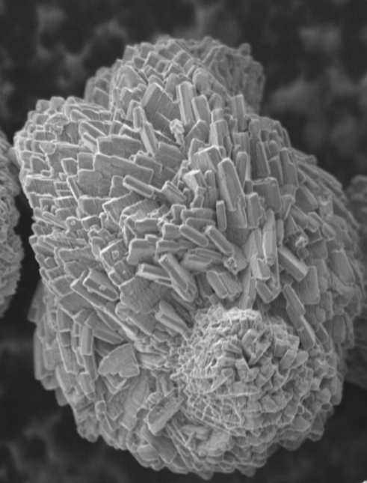

What nanoparticles can……
LOVE

Slide 13






Nanotechnologies in/from Olomouc
2011
2010-2014 ESF support by Operational Program Research and Development for Innovations (25 mil. Euro, 100 scientists in 2014)
+ 2013
Name SURNAME
xxxxxxxxxxxxxxxxxxxxxxxxxx

Slide 14






Distinguished and visiting scientists, collaborators
Prof. P. Hobza
RCPTM
H-index: 78
∼ 21 000 citations
non-covalent interactions
Prof. M. Gratzel
EPFL Lausanne
H-index: 140
93 000 citations
iron oxide films
Prof. A. Gedanken
Bar Ilan University, Israel
H-index: 65
∼ 15 000 citations
contract from January 2012
Nanometals, sonochemistry
Prof. R. Varma,
US Environmental Protection Agency,
H-index: 60
∼ 12000 citations
Green chemistry, nanotoxicity
Prof. E. P. Giannelis
Cornell University
H-index: 52
18 000 citations
carbogenic quantum dots
Prof. S. Ohkoshi
University of Tokyo
H-index: 46
7000 citations
magnetic nanoparticles
Name SURNAME
xxxxxxxxxxxxxxxxxxxxxxxxxx

Slide 15




Iron based nanomaterials…
Iron age in nanotechnologies
targeted drug delivery
cell labeling and separation
magnetic fluid hyperthermia
MRI contrast enhancement
water treatment technologies
heterogeneous catalysis
dye-sensitized solar cells
M. Hermanek, R. Zboril et al.
J. Am. Chem. Soc.
129, 10929, 2007.
K. Sivula, R. Zboril et al.
J. Am. Chem. Soc. 132, 7436, 2010; I. Cesar, JPC-C 113, 772, 2009.
Bakandritsos et al. SMALL 8, 2381, 2012; ADV. FUNCT. MATER. 18, 1694, 2008; NANOSCALE 2, 564, 2010.

Slide 16









Iron oxide based nanomaterials – synthetic approach
α-Fe₂O₃
α-FeO(OH)
+ H₂
air
α-Fe
+ H₂O
FeOOH
20 nm
Fe
+ N₂
FeO
Fe/FeO
+ N₂(2%O₂)
Hydrogen furnace
α-Fe

Slide 17




Nanoscale zero valent iron (nZVI) for water treatment technologies
nZVI – environmentally friendly reduction technology of treatment of ground water.
Applicable for removal of more than 70 pollutants, e.g. chlorinated hydrocarbons arsenic, uranium, chromium, heavy metals, herbicides, nitrobenzen and nitro-derivatives, dioxine, PCB, phosphates etc.
The first European producer of nZVI in a large scale. Pilot and full-scale remediation at various localities in Europe and US.
(e.g. AQUATEST, CZ; AECOM, USA, GEO LAB USA)
J. Filip, R. Zboril et al. EST. 41, 4367 (2007).
R. Zboril et al.: PCT/CZ2008/000040
Slurry feeding during treatment. © Aquatest, Czech Republic
Remediation in Pisecna © Aquatest, CZ

Slide 18

Nanoscale zero valent iron (nZVI) for water treatment technologies
C
[mg/L]
Treatment of Cr(VI)
KARA Trutnov,CZ, 2011; remediated by: ECORA
Decrease of chlorinated ethenes after 1 year from injection of nZVI (locality Pisečná, CZ, 2010); remediated by AQUATEST
C
[µg/L]
Treatment of chlorinated ethenes
KARA Trutnov,CZ, 2011; remediated by ECORA

Slide 19





Nanoiron in the fight with cyanobacteria
High and selective toxicity against cyanobacteria
Toxicity against daphnia, water plants and fishes is 2-3 orders of magnitude lower!
Deformation of cells
Cell
destruction
Original cells
B. Maršálek et al. EST 46, 2316, 2012; R. Zbořil et. al. PCT/CZ2011/0075

Slide 20


Nanoiron as a multipronged weapon against cyanobacteria
ccommercial herbicide
In spite of the cell destruction, microcystin is not released in the water column!
Before
After nZVI treatment
4 modes of action:
Preventive mode – removal of bioavailable phosphorus.
Destructive mode – cell destruction
Immobilization mode – ability to immobilize microcystin on the large and positively charged surface of the non-toxic and environmentally benign ferric hydroxide
Physical mode - formation of a highly flocculated waste product consisting of destroyed biomass
and Fe(OH)₃
B. Maršálek et al. EST 46, 2316, 2012; R. Zbořil et. al. PCT/CZ2011/0075.

Slide 21






Nanoferrates (IV,V,VI) for advanced water treatment
Collaboration with ASIO; Patent application
Reactor for ferrates application working in nitrogen atmosphere
Control and measurement of pH, ORP, temperature, dosage
- High efficiency of removal of e.g. aromatic compounds, cyanides, heavy metals, chemical warfare agents, arsenic
Environmentally friendly in-situ applicable technology;
magnetically separable product; arsenic embedded in crystal lattice
R. Zboril et al. J. Hazard. Mater. 211, 126, 2012.
J. Filip et al. Chem. – Eur. J. 17, 10097, 2011;
.

Slide 22




Magnetic Iron oxide nanoparticles for MRI imaging
a one-step thermal decomposition of iron(II) acetate in air at 400 °C ⇒ nearly monodispersed superparamagnetic maghemite nanoparticles
γ-Fe₂O₃
After disperison in bentonite matrix ⇒ highly effective and cheap peroral MRI negative contrast agent for gastrointestinal tract
γ-Fe₂O₃/bentonite
γ-Fe₂O₃/bentonite
extraluminal metastases
gall stone
2010-2011: clinical trials with more than 100 patients (FN Olomouc, Banska Bystrica)
negotiation on the license conditions – MEDIHOPE, GML Health Care
small bowel
Lumirem
K. Kluchova, R. Zboril et al. Biomaterials 30, 2855, 2009.
M. Maslan et al. Patent No. 300445 Accepted 9. 4. 2009.

Slide 23




Iron oxide films for direct solar splitting of water
Mesoporous hematite prepared by a solution-based colloidal approach ⇒ a drastic effect of sintering temperature on the photoactivity effieciency due to Sn doping
K. Sivula, R. Zboril et al. J. Am. Chem. Soc. 132 (2010) 7436-7444.

Slide 24




More on iron oxide nanoparticles
R. Zboril, M. Mashlan, D. Petridis: Iron(III) oxides from thermal processes - synthesis, structural and magnetic properties, Mössbauer spectroscopy characterization, and applications, Chem. Mater. 14 (2002) 969-982.
L. Machala, R. Zboril, A. Gedanken: Amorphous iron(III) oxide – a review, J. Phys. Chem. B 111 (2007) 4003-4018.
J. Tucek, R. Zboril, A. Namai, S. Ohkoshi, Chem. Mater. 22 (2010) 6483-6505.
L. Machala, J. Tuček, R. Zboril: Polymorphous transformation of nanometric iron(III) oxide: A review, Chem. Mater. 23 (2011) 3255-3272.

Slide 25







Nanosilver - new chance in fight with bacteria and fungi?
Synthesis and functionalization of Ag NPs
Immobilization of NPs on solid substrates
Antibacterial, antifungal activity, cytotoxicity
Medical and disinfection applications
Candida spp.
25 nm 200 nm 400 nm
Drastic effect of particle size on antibacterial activity
A. Panáček et al. J. Phys. Chem. B. 110 (2006) 16248; more than 350 citations.
Antifungal activity even higher compared to commercial fungicides
A. Panacek al. Biomaterials 30 (2009) 6333-6340.

Slide 26




Toxicity of nanosilver against eukaryotes and higher organisms
Ag NPs ~25 nm
Drosophila melanogaster
Paramecium caudatum
Acute toxicity > 20 mg/L
A. Panacek et al. EST 45 (2011) 4974.
Cytotoxicity to human fibroblasts
Ag⁺
Ag⁰
1 h LC50 = 39 mg·L⁻¹
⇒ 10x lower toxicity compared to bacteria, yeasts and fungi
L. Kvitek et al JPC- C 113 (2009) 4296;
A. Panacek al. Biomaterials 30 (2009) 6333.
LC50(Ag⁰) ~ 30 mg/L
LC50(Ag⁺) ~ 1 mg/L

Slide 27








Covalent immobilization of nanoAg –
new generation of antimicrobial coatings
Reusable antimicrobial
dispersions
Z. Markova et al. Green Chem. 14, 2550, 2012. R. Prucek et al. Biomaterials 32, 4704, 2011; Dallas et al. Adv. Funct. Mater. 20, 2347, 2010.
Polymer acts simultaneously as a reducing agent and substrate for covalent immobilization of nanoAg – no release to environment, no need of extra reducing agent!
P. Dallas et al Macromol. Mater. Eng. 295, 108, 2010.
Covalent antimicrobial modification of textile fibers and filtration membranes – MEGA, a.s.

Slide 28




NanoAg antimicrobial coatings for medical applications
NanoAg-PEI coating of tracheostomy cannulas;
Stage of clinical trials (UVN Prague, KARIM); negotiation on the license conditions (Biomedica, s.r.o.)
R. Zbořil, J. Soukupová, Patent No. 303502, accepted 12. 9. 2012; PCT/CZ2012/000068.
Modification of surgical thread
Challenge:
NanoAg induced activation of ATB against resistant bacterial strains;
in vitro testing completed; stage of in vivo trials with animal models

Slide 29


More on nanosilver…
P. Dallas, VK Sharma, R. Zboril Adv. Colloid Interface Sci 166 (2011) 119.
Suggested mechanisms of antimicrobial action
Synthetic approaches towards silver nanocomposites
Thin films, covalent immobilization
Applications

Slide 30




Carbon nanostructures
2D graphene,
synthesis,
derivatives,
functionalization
0.6 nm
1D nanotubes,
functionalizationapplications
perfluoro-alkylsilan
OD carbon dots,
synthesis,
functionalizationapplications
Chem. Mater. 20 (2008) 2884;
Chem. Mater. 20 (2008) 4539.
Small 4 (2008) 455.
Small 5 (2009) 1841.
Chem. Commun.46 (2010) 1766.
Small 6 (2010) 2885.
Chem. Mater 24 (2012) 6.
J. Mater. Chem. 22 (2012) 16219.
5 nm

Slide 31



Carbon based quantum dots
Thermally induced solid-state syntheses starting from organic precursors (citrate, betaine etc.)
Various surface
functionalities
5 nm
Advantages compared to common (CdSe) QDs:
Large scale production
Biocompatible nature, low toxicity (CHNO)
Surface functionalized » possibility to bind other species » multifunctional hybrids
Two sources of fluorescence: carbon core, organic surface layer
Magnetic properties
Bourlinos et al. Chem. Mater. 20 (2008) 4539; Small 4 (2008) 455; Chem. Mater 24 (2012) 6; Krysman et al. JACS 134 (2012) 747.
Ferromagnetism of CDs!
Srivastava et al. ChemPhysChem 12 (2011) 2624.

Slide 32







Carbon nanocomposites and their applications
Magnetic Fe₃O₄/C-dots
Gd doped C-dots
Nanocarbon/iron composites
CMK-3 carbon
T1-weighted images
rat mesenchymal stem cell labeling
dual MRI/fluorescence probes
advanced sorption-reduction water treatment technologies - GEOTEST
T2-MRI
T1-MRI
Z. Markova et al. J. Mater. Chem. 22 (2012) 16219;
AB Bourlinos et al. J. Mater. Chem. 2012, in print.
M. Baikousi et al. Langmuir 28 (2012) 3918.

Slide 33




Graphene – synthesis, organic functionalization, interactions with metals
1 h
graphite in pyridine
Synthesis
graphite in benzene
5 days
Chemical exfoliation of graphite by perfluorinated aromatic molecules or pyridine as solvents.
Organic functionalization
1,3 dipolar cycloaddition of azomethine ylide. Graphene-OH sheets are easily dispersible in polar organic solvents and water.
Interactions with metals
Small 5 (2009) 1841; Chem. Commun.46 (2010) 1766; J. Phys. Chem. C 116 (2012) 14151.

Slide 34




Fluorographene - world's thinnest insulator
Liquid phase exfoliation of graphite fluoride (CF) with sulfolane.
First stoichiometric graphene derivative.
The world's thinnest insulator (~3 eV).
Stability higher compared to CH, CCl, CBr.
Suggestion of 2D semiconductors
C₂FCl
C₃F₂Br
band gap ∼ 1eV
Band gap engineering in graphene halides
Zboril et al. Small 6 (2010) 2885.
Nair et al. Small 6 (2010) 2877.
Karlicky et al. J. Chem. Phys 137 (2012) 34709.

Slide 35

More on graphene
V. Georgakilas, Chem. Rev., DOI: 10.1021/cr3000412, 2012.
Covalent and non-covalent functionalization
Derivatives
Applications

Slide 36
Acknowledgements
Academic partners:
Colleagues from RCPTM; AB Bourlinos, M. Karakassides (University of Ioannina, Greece, carbon hybrids); EP. Giannelis, M. Krysman, P. Dallas (Cornell University, carbon dots); S. Ohkoshi (University of Tokyo, magnetic nanoparticles); V. Georgakilas (NCSR Demokritos, Athens, graphene functionalization); VK Sharma (Florida Institute of Technology, ferrate technologies); K. Sivula, M. Gratzel (EPFL Lausanne, solar splitting of water); A. Gedanken (Bar-Ilan University, Israel, antimicrobial NPs); KS Kim (Pohang Institute of Technology, Korea, graphene applications); R. Varma (US EPA, toxicity of NPs, nanocatalysis); P. Mulvaney (University of Melbourne, Australia, quantum dots); F. Vianello (University of Padua, biosensors)
Commercial partners:
AECOM US, GEOLAB US, DEKONTA, AQUATEST, GEOTEST, MEGA, AECOM CZ, ECORA (water treatment technologies, pilot testing, full scale remediation)
MEDIHOPE, BIOMEDICA, GML HEALTH CARE, FN Olomouc, UVN Prague, FN Banska Bystrica (antimicrobial treatment, medical applications, in vivo testing)
Grant support:
ESF/MŠMT: 2010-2015: CZ.1.05/2.1.00/03.0058: „Regional Centre of Advanced Technologies and Materials“
NANOREM - (309517 FP7-NMP-LARGE-6) „Taking Nanotechnological Remediation Processes from Lab Scale to End User Applications for the Restoration of a Clean Environment“
TAČR: 2012-2019: TE01020218 Centre of competence: „Environmentally friendly nanotechnologies and biotechnologies for water and soil treatment“
GAČR: 2012-2018: P208/12/G016: Centre of Excellence "Controlling structure and function of biomolecules at the molecular level: theory meets experiment“

