Slide 1
Opportunities and Risks of a Transatlantic Trade and Investment Partnership:
Will Food and Agriculture
Be a Stumbling Bloc?
Stefan Tangermann
Learned Society of the Czech Republic, Prague, 21 April 2015

Slide 2
Outline
Regional Trade Agreements:
Is TTIP a Special Case?
EU-US Trade Relations in Agriculture:
50 Years of Conflicts and Convergence
Negotiating Positions in the TTIP Negotiations
Conceivable Landing Zones for a TTIP

Slide 3
Regional Trade Agreements:
Is TTIP a Special Case?

Slide 4
What is TTIP?
In June 2013, EU and US started negotiations on a comprehensive free trade agreement:
Transatlantic Trade and Investment Partnership
(TTIP)
TTIP is supposed to result in
  elimination of tariffs
  reduction of non-tariff barriers to trade
  (less divergence of regulatory measures)
  other agreements
  (e.g. Investor-State Dispute Settlement)

Slide 5
A Long History of (Failed) Attempts
In the past, EU and US have for a long time tried to strengthen their economic co-operation
There have even been attempts at creating
free trade between the EU and the US,
e.g. plans for
  North-Atlantic Free Trade Agreement (NAFTA),
  early 1970s
  Transatlantic Free Trade Area (TAFTA), in the 1990s
Since 1990 EU-US Economic Summits

Slide 6
TTIP – A Historical Breakthrough?
Actual progress in improving economic relations across the Atlantic was very limited
  a few Mutual Recognition Agreements
  a rather limited Veterinary Equivalence Agreement
November 2011 EU-US Summit established
High-Level Working Group
... which issued final report in February 2013, suggesting "to launch negotiations on a comprehensive trade and investment agreement"
Against this background, TTIP negotiations are a rather courageous endeavour

Slide 7
Regional Trade Agreements (RTAs)
RTAs have become an important feature of international trade
... in spite of the GATT/WTO emphasis on
non-discrimination
There are now more than 585 RTAs in global trade
EU has concluded 36 RTAs (with Albania, ..., Korea, ... , Mexico, ..., Switzerland, ..., Ukraine)
EU is currently negotiating on 12 more RTAs
(with India, ..., Japan, ..., Canada, ..., USA)

Slide 8
TTIP: A Special Case?
None of the previous RTA negotiations of the EU has attracted much attention in general public
TTIP is a different case:
  it would be a mega-regional arrangement, covering a large share of global international trade
  (but not 30-40% as sometimes suggested – "only" 4.5%)
  there is a lot of resistance among NGOs and general public, in particular in Germany and Austria

Slide 9
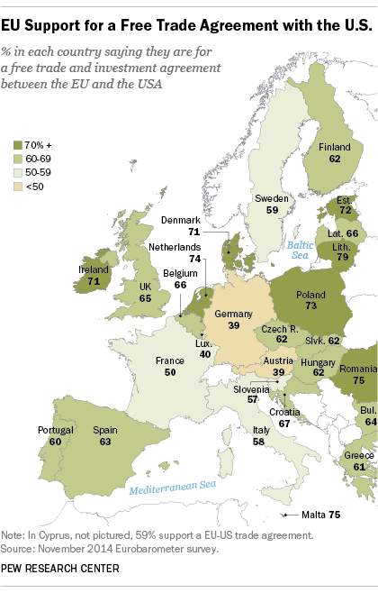

Slide 10
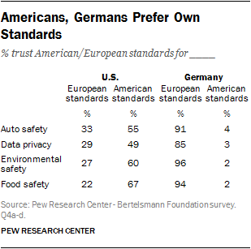
Germans don't trust US standards

Slide 11
Will Food and Agriculture
Be a Stumbling Bloc for TTIP?
There are a number of issues related to food and agriculture that could get in the way of finding an agreement in the TTIP negotiations, including
  "chlorine chicken"
  free trade in GMO products
  hormone treated beef
  protection of Geographical Indications for traditional foods
Are fears regarding these issues justified?

Slide 12
EU-US Trade Relations in Agriculture:
50 Years of Conflicts and Convergence

Slide 13
EU-US Conflicts on Agricultural Policy
Since formation of the EEC (1968) and establishment of the Common Agricultural Policy (1962) there were frequent conflicts in EU-US agricultural trade
Example: "Chicken War" of 1963:
  EEC introduces higher tariffs on chicken imports
  US imposes retaliatory tariffs on VW pick-ups and Cognac
Example GATT negotiations:
  liberalization of global trade failed because of agriculture
  until the Uruguay Round (1986-94) achieved a breakthrough (WTO Agreement on Agriculture) after tough negotiations between the US and the EU ("Blair House" agreements)

Slide 14
Background:
EU provides much more farm support than US
Indicator PSE% (Producer Support Estimate)
Share of government support in farm revenue
Source: Josling and Tangermann (forthcoming)
Since early 1990s there were reforms of farm policy in US and EU
farm support reduced, less market distortions: partial convergence

Slide 15
EU agricultural tariffs remain high
Average tariffs for individual
product groups
Maximum tariffs within
individual product groups
Source: Josling and Tangermann (forthcoming)

Slide 16
Bu there are also non-tariff measures (NTM)
NTM are regulatory measures that impede imports as they differ from country to country
Many NTM are indispensible
(e.g. import ban for animal products from countries with foot and mouth disease)
Many divergences of regulatory measures have only historical reasons (path dependency), e.g.
  turn-signal indicators have to be yellow in EU, red in US
  regulations regarding cover of cans for spraying cream differ between EU and US
... and this creates unnecessary costs

Slide 17
Quantitative significance of NTM
Tariff equivalents of NTM in EU and US
are larger than average tariffs
Source: Ecorys (2009)

Slide 18
Convergence in agricultural polcies,
Divergence in NTM
EU-US conflicts on tariffs, subsidies for agricultural products have been largely resolved through WTO Agreement on Agriculture and farm policy reforms
But conflicts regarding regulatory measures have intensified significantly
(food safety, food labeling, ...)

Slide 19
EU agricultural and food exports to US are larger than imports from US
Source: Josling and Tangermann (forthcoming)

Slide 20
Negotiating Positions
in the TTIP Negotiations

Slide 21
Will TTIP bring an end to EU-US conflicts in agriculture?
Against the historical background, negotiations on free trade in food and agricultural products between the EU and the US are a courageous endeavour
Complete elimination of tariffs will be difficult
But reduction of regulatory divergences (NTM) will be even more difficult
... and that is focus of public attention

Slide 22
"Free trade" and NTM
Reduction of NTM in bilateral EU-US trade is a central aim of TTIP
This will take the form of reducing regulatory divergences, but not eliminating regulatory measures
"free trade" under RTAs (and TTIP) does not imply complete opening-up of borders
Which NTM are reduced is a matter of negotiations, there is no automatic result,
no firm requirement in the WTO

Slide 23
NTM and the international trading regime
WTO Agreement on the Application of Sanitary and Phytosanitary Measures (SPS)
requires among others
  measures must be based on scientific evidence
  measures should be based on international standards
  (e.g. CODEX)
WTO Agreement on Technical Barriers to Trade (TBT)
WTO Agreement on Trade Related Aspects of Intellectual Property Rights (TRIPS)

Slide 24
The case of beef hormones (1)
In the US, use of hormones as growth promoters in beef fattening is permitted,
hormones are used in ~ 90% of large cattle herds
In the EU, use of hormones in cattle feed is banned since 1989 (after cases of illness in Italy and decline in consumption of veal meat)
US have launched dispute cases against EU in GATT and WTO; decision: EU has not conducted appropriate risk assessment, should not block imports

Slide 25
The case of beef hormones (2)
US imposed punitive tariffs on imports from EU
Dispute was then settled: EU continues to block imports of hormone treated beef, but opened up tariff rate quota for hormone-free beef imports
Scientific studies cannot prove any risks related to hormone treated beef – but also not contrary
US continues to push for opening up of EU markets for imports of hormone treated beef

Slide 26
The case of GMO crops (1)
In US, GMOs are used on ~ 90% of area planted to maize, soybeans and cotton
EU has approved import of more than 50 varieties of GM crops for use (mainly in feed)
... but process of approval is slow, even after EFSA has decided positively
EU has approved only two GM varieties for planting (maize MON810, potato Amflora)
... and Member States can ban planting even after positive vote of EU Commission (based on positive decision of EFSA), on purely political grounds

Slide 27
The case of GMO crops (2)
US has brought WTO case against EU (2003) and largely won the case, but does not pursue it
US pushes for acceleration of EU approval process for use
... but has, for the time being, largely given up on hopes to achieve EU approval for planting

Slide 28
The case of "chlorine chicken" (1)
US has approved pathogen reduction techniques for cleansing of carcasses (chlorine wash, lactic acid and other antimicrobials)
US is second largest global exporter of chicken
EU has banned these techniques for chicken in 1997, on the grounds that they can cover lack of hygiene in production process
US has brought WTO case in 2009, but does not pursue it currently; has proposed practical approaches

Slide 29
The case of "chlorine chicken" (2)
CODEX considers use of chlorine wash safe (2011)
EFSA found chlorine wash safe
... which led EU Commission to propose approval,
but Council of Ministers voted against
Majority of scientists in EU favour approval of chlorine wash, given significant microbial contamination of chicken from EU slaughterhouses
In 2013, EU has approved lactic acid wash for cattle carcases (but not for chicken)

Slide 30
EU has also requests to US, for example:
Reduction of excessive food safety standards for fresh milk products ("Grade A" regulations)
Approval of raw milk cheese matured less than 60 days
Expeditious approval of imports of plants, fruit, vegetables (US checks often take more than 10 years; US: positive list – EU: negative list)
Protection of EU Geographical Indications
(e.g. "Gouda" and "Brie" are considered generic terms in US and thus not protected)

Slide 31
Conceivable Landing Zones
for a TTIP

Slide 32
TTIP negotiations are in full swing
Difficult to predict outcome,
and eventual success is not certain
Negotiations may drag on well into 2016
(or even until after November 2016 US presidential elections)
If a TTIP is agreed, many issues in the domain of regulatory measures will remain open,
to be resolved later in joint EU-US committees

Slide 33
Conceivable results of negotiations
Remember: treatment of NTM is matter of negotiations – US cannot force US standards on EU
Conceivable outcomes:
  beef hormones: no change to current status
  GMO crops: EU accelerates approval process for use,
  but does not change current status for planting
  "chlorine chicken": joint EU-EU body develops proposals for approach to pathogen reduction techniques
  Geographical Indications: list of selected EU GIs to be protected in US

Slide 34
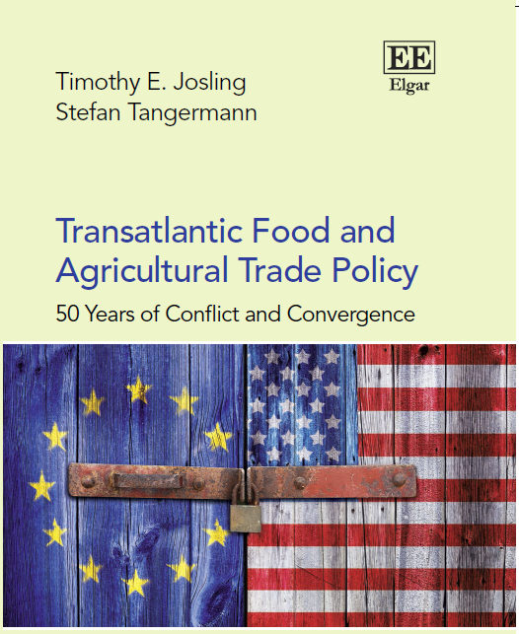
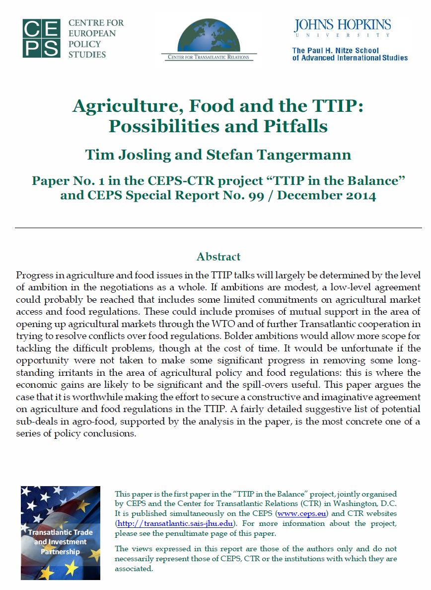
References

