Slide 1
Adaptation towards sustainable consumption and production
Professor Sir Brian Heap,
EASAC President
St Edmund’s College
Cambridge CB3 0BN

Slide 2
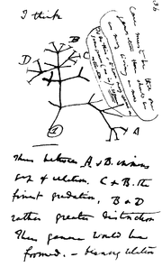
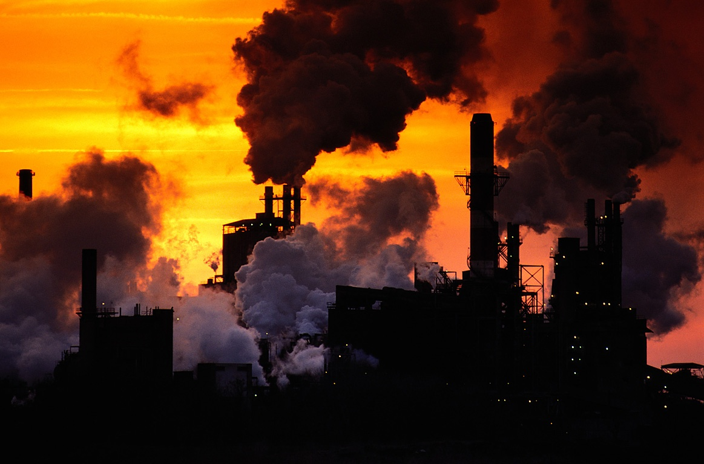
Notes:
Two years ago we celebrated the 200th anniversary of Darwin’s birth and the 150th anniversary of the publication of the ‘Origin of Species’.
We revisited Darwin’s great new idea about natural selection as the agent of evolution, the phenomena of competition and adaptation, and how they are central in the struggle to survive in a changing environment.
Darwin’s landmark insights were formulated in the heat of the industrial revolution when the key incentive was the pursuit of profits.
Firms competed by investing in new technologies and by reducing costs of production.

Slide 3
‘….capitalism has stimulated human creativity and aggression in ways that have produced immense benefits….. capitalist freedom is a two-edged sword……..A ferocious international struggle is underway to secure access to scarce resources….which has produced a world of potentially financial instability’
'Capitalism and Freedom’(2008) Peter Nolan, Director of the Chinese Big Business Programme (CBBP), Judge Business School, Cambridge
Notes:
It resulted, as Peter Nolan has pointed out, in a form of capitalism that stimulated human creativity and aggression in ways that produced immense benefits to humankind.
Yet, says Nolan (2008), capitalist freedom is a two-edged sword and there is now a ferocious international struggle underway to secure access to scarce resources...which has produced a world of financial instability’

Slide 4
Transformational elements:
Examine the systems to see if they can provide a ‘plenitude of everything for everyone’
2. Adoption of sustainable consumption and production (SCP) as trustees of the future
3. Adaptation to universal principles of morality in choosing our own destiny
Notes:
Three transformational elements for the more- and over-developed nations will be discussed:
first, examination of the current systems, questioning if they will lead to sustainable development;
second, adoption of sustainable consumption and production (SCP) as trustees of the future;
third, adaptation to universal principles of morality in choosing our own destiny

Slide 5
Examine the systems
The top 20 % of the world's rich consume 85 % of total commodities.
Establish a set of Millennium Consumption Goals for the period 2012-2020 and for subsequent decades, complementing the Millennium Development Goals in order to:
to ensure that the basic needs of the poor are met
preserve and strengthen earth’s natural resource base
enhance global prosperity
improve intra- and inter-generational equity
accelerate the shift to more sustainable consumption and production
Mohan Munasinghe (Rio+20, June 2012)
Notes:
1. Examine the systems
The top 20 % of the world's rich consume 85 % of total commodities.
Establish a set of Millennium Consumption Goals for the period 2012-2020 and for subsequent decades, complementing the Millennium Development Goals in order to:
to ensure that the basic needs of the poor are met
preserve and strengthen earth’s natural resource base on which human society depends
enhance global prosperity, while ensuring a good quality of life and well being for everyone
improve intra- and inter-generational equity
accelerate the shift to more sustainable consumption and production as an essential step towards the ultimate goal of sustainable development

Slide 6
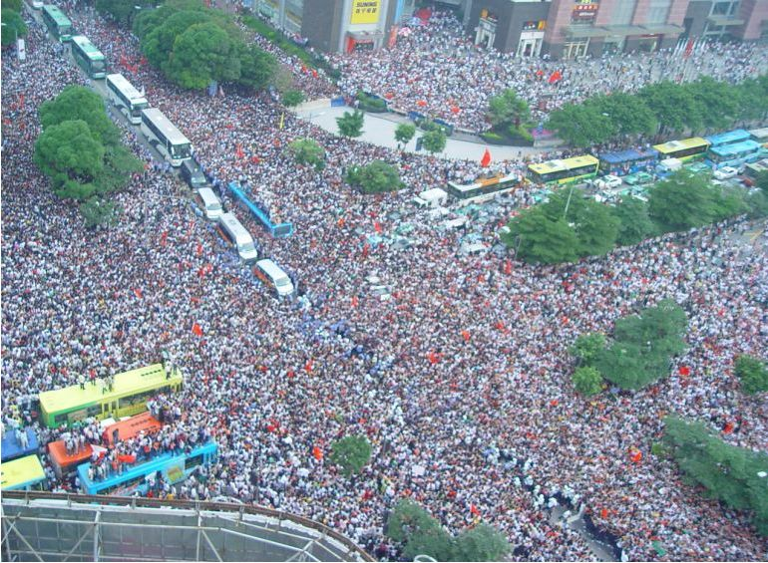
Consumption and population
May 2008, crowds in Shenzhen, China welcoming the Olympic Torch
Notes:
Consumption has risen with the global increase in the number of people on the planet and this has placed great pressures on the finite resources of the planet. We live on a crowded planet, and today 925 m people experience hunger, another 1bn are thought to suffer from ‘hidden hunger’ because of mineral and vitamin deficiency, yet another 1 bn overconsume leading to obesity and type II diabetes.
World population started to grow exponentially about 200 years ago, doubled in the past 50 years, and will reach a medium figure of about 9 billion by 2050. Growth will eventually stabilise or crash as Thomas Malthus envisaged, either because of fertility control, socio-economic factors, or exhausted ecosystem services.
Therefore, decisions taken now will determine whether we reach the UN’s high projection of 10.5bn, a medium of 9bn, or a low of 7.8bn (http://gpso.wordpress.com).

Slide 7
Prosperity is increasing (Musser 2005)
Fold increase 1950-93 1995-2050
Population 2.2 1.6
Food 2.7 1.8
Energy 4.4 2.4
GDP 5.1 4.3
World GDP pc ($ 1990 x ‘0000); population in extreme poverty (bn)
Notes:
Global prosperity has had a long record of providing more goods and services. This has been a driver of global consumption and production.
Global economic growth (5-fold) has been greater than the increases in energy (4.4), food (2.7) and population (2.2). They have all increased during the second half of the last century and this is projected to continue into the first half of this century.
Market-driven consumption particularly in high-income countries has been driven by a seemingly unlimited source of financial loans. Greater numbers then ever before have aspired to a lifestyle advertised as the American dream.

Slide 8
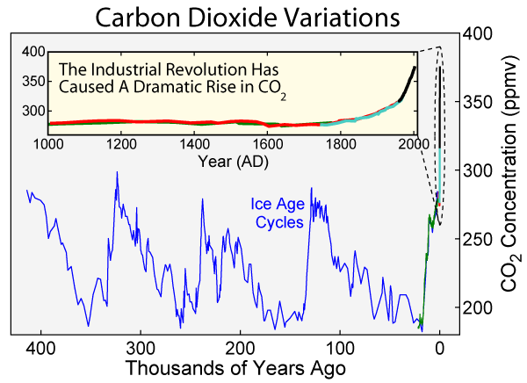
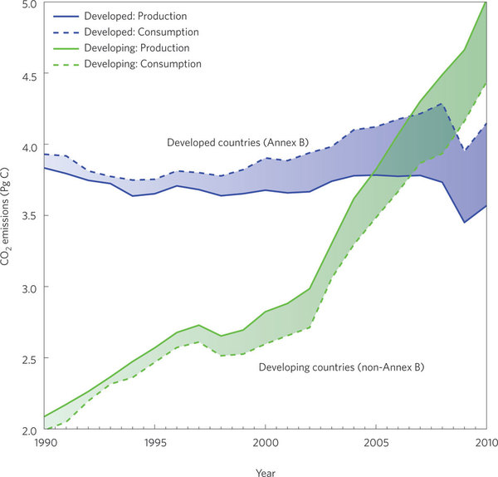
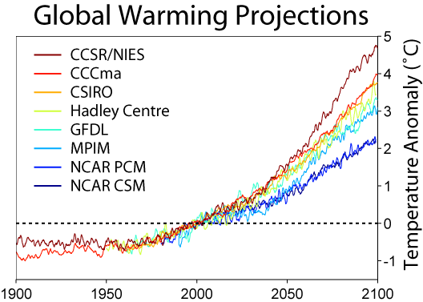
Global climate change (Rohde 2006, Global Warming Art)
CO₂ emissions from 1990 to 2010 of developed and developing countries with emissions allocated to territorial production and the consumption of goods and services (production + imports -exports). Peters et al. Nature Climate Change 2: 2 2012
Notes:
The two-edged nature of capitalist freedom becomes apparent when we consider its effect on the environment. Economic growth in high-income countries has been associated with a 30% increase in global concentrations of greenhouse gases in the atmosphere since the time of the industrial revolution.
This has been caused by the burning of fossil fuels, deforestation, intensive agriculture and other land-use changes.
CO₂ persists for over 100 years in the stratosphere and heat that has been trapped in the earth’s atmosphere means that further planetary warming is inevitable.
Even if we stabilise greenhouse gas concentrations at their present values today, which may be beyond us, global warming is expected to continue.

Slide 9
Impacts of unsustainable consumption and production
Climate change
Biodiversity loss
Threats to health
Energy crisis
Food crisis
Water crisis
Housing crisis
Barber (2010) Still Waiting for Delivery A review of progress and programs in the 10-year framework International Coalition for Sustainable Production and Consumption
Notes:
So, we can see how population growth, increased use of resources, and unsustainable production and consumption have social and environmental impacts through of unsustainable consumption and production.
This is a challenge that will affect the poorer more than the richer nations of the world because poorer nations have less resilience and less resources to adapt quickly enough to prolonged and unsustainable practices.
Can science and technology help us to account for our current actions and adopt SCP as trustees of the future? We will examine briefly selected sectors.

Slide 10
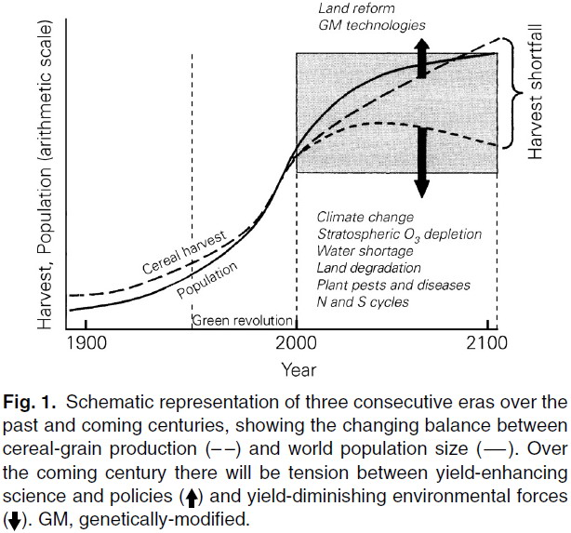
2. Adoption of sustainable consumption and production (Lu Bao-rong, 2010)
Notes:
2. Adaptation to sustainable consumption and production
Food production
Global food production has become unsustainable. Over the past 50 years production has increased three-fold by the adoption of new technologies and in particular through plant breeding.
But pressures now exist to move towards more sustainable methods of food production. Many more people will be wealthier creating demand for more varied, high-quality diets that require additional resources to produce. Competition for land will increase, and the effects of climate change will become greater.
During the past 50 years there has been a loss of land to urbanisation, soil degradation, desertification, erosion, overgrazing, salination and pollution. These drivers of change call for decisive action now from policy makers.

Slide 11
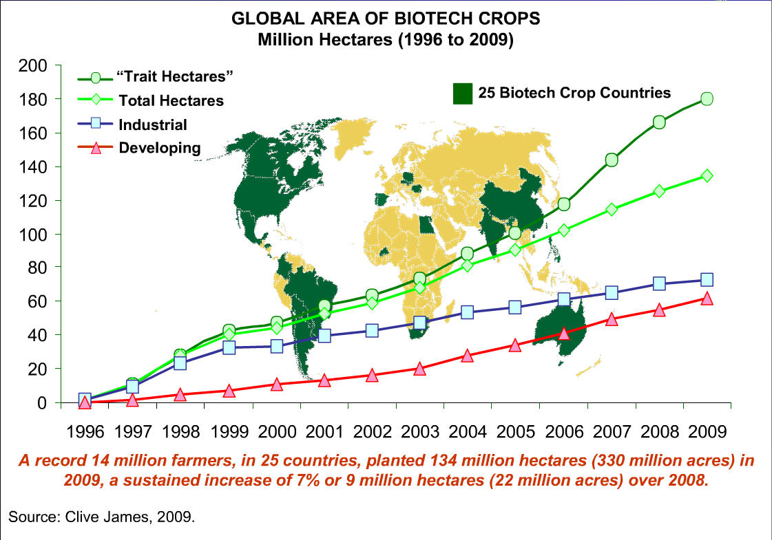
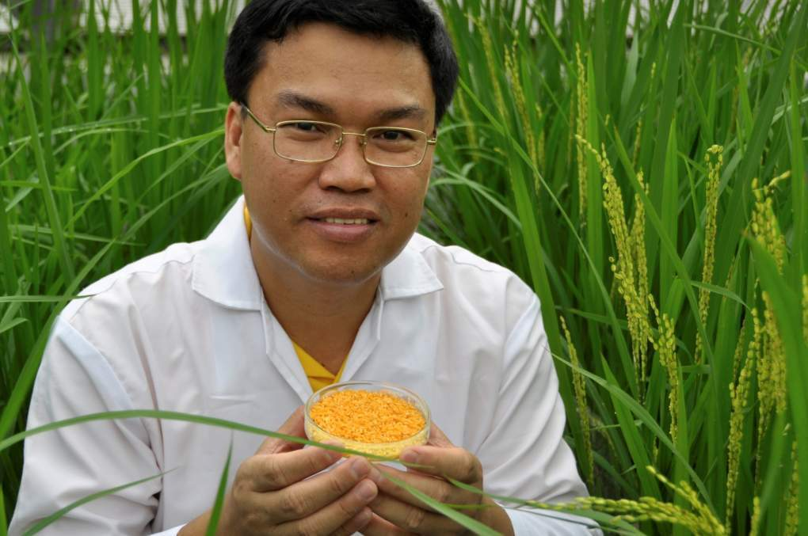
Vitamin A deficiency is a leading cause of childhood blindness
In 2010: 14m farmers, 130m ha grown
Since 1996: +$65bn income
-393m kg pesticide
17% reduction in env. impact
(Brookes and Barfoot 2011)
40 grams of Golden Rice
a day will save life and sight
Notes:
New advances in plant breeding (including genetically modified crops) would help to produce food in a more sustainable way and improve the health of children. GM crops can reduce the chemical burden on the environment, diminish waste, pollution and labour, and provide greater safety for farmers who are exposed to lower levels of pesticides. They will also help to grow crops in hostile places such as semi-arid conditions.
In China, insecticide use has fallen by 156 million pounds after the introduction of GM cotton, equivalent to the entire amount of spray used in California each year.
Every year 2.2 m children die and many become blind every year from vitamin A malnutrition. This could be prevented with GM rice – so-called Golden Rice.
Opponents argue that GM plants could harbour unknown risks and pose a threat to human health, the environment and biodiversity, but after more than 20 years experience such fears are unfounded.

Slide 12
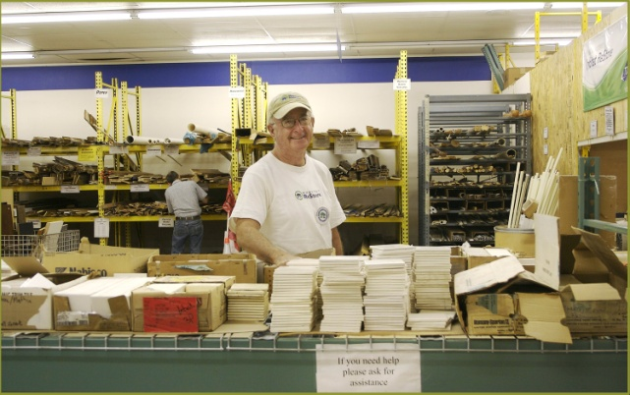
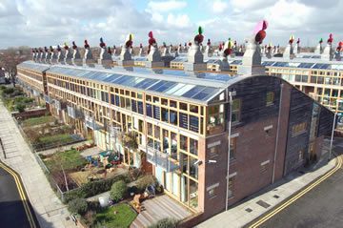
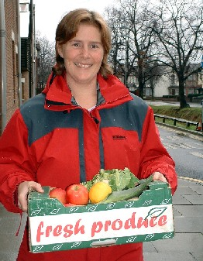
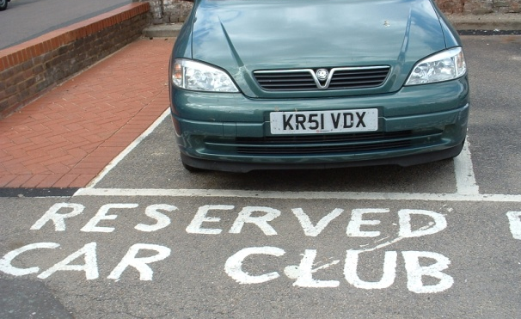
BioRegional works with partners to demonstrate solutions for…
Products & supply chains: wood, construction materials, food, paper
Communities: new, retrofit, energy, transport, sustainable lifestyles
Notes:
Construction
The construction industry has started to experiment seriously with ways to improve energy efficiency by the use of new materials and processes to reduce the carbon footprint of new and existing buildings.
The International Energy Agency says that buildings worldwide account for more than 40% of primary energy use and 24% of greenhouse gas emissions.

Slide 13
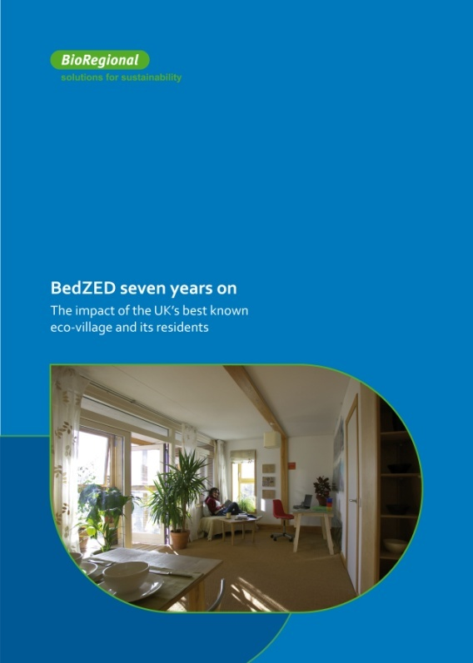
Monitoring results summary (2007)
Electricity use 45% lower than local average, space heating 81% lower than local average = total energy saving from buildings 60%
Water use 50% lower than local average
86 % residents buy organic food
39% grow some of their own food
60% of waste (by weight) recycled (though small sample size)
www.bioregional.co.uk/news-views/publications
Notes:
One example in the UK is the Beddington zero energy project organised by Bioregional.
Beddington Zero Energy Development (BedZED) is an environmentally friendly housing development in the London Borough of Sutton. It demonstrates several features of sustaiable consumption and production – doing more with less.

Slide 14
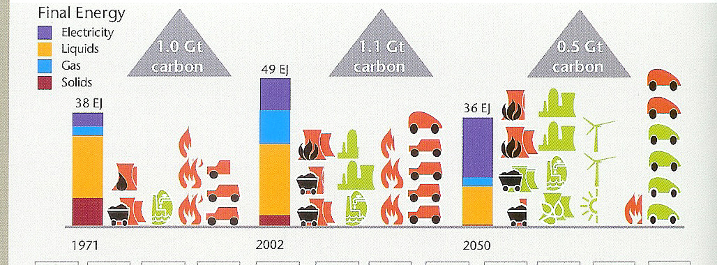
Energy infrastructure in the EU-25
Notes:
Energy
Energy presents one of the greatest challenges for a paradigm of SCP since energy usage has been about non-renewable consumption. The EU has established ambitious energy and climate change objectives. A commitment has been made to substantially decarbonise energy supply, with a target to reduce EU greenhouse gas emissions by 80–95% compared with 1990 levels by 2050. This requires the EU’s electricity system to achieve essentially zero emissions of greenhouse gases by 2050 (European Commission, 2011).
The central goals of EU energy policy – security of supply, competitiveness and sustainability – have been laid down in the Lisbon treaty (European Union, 2007).
Energy infrastructure in the EU has started to go down the path of greater efficiency. Carbon for energy needs has been reduced by 0.75% per year (dematerialisation; 1.1 Gt of carbon utilised to produce 49 exojoules (1x10¹⁸) of energy).
Over the next 50 years that rate of change will need to double which means in practical terms finding alternative sources to provide for basic necessities.

Slide 15
3. Adaptation to universal principles of morality in choosing our own destiny
…well-designed laws and public policies can harness self-interest for the common good
…incentives that appeal to self-interest may fail when they undermine the moral values that lead people to act altruistically or in other public-spirited ways
Adam Smith (1759) The Theory of Moral Sentiments
Notes:
3. Adapt to universal principles of morality and choose our own destiny
Questions have now been raised about the value systems that underpin growth and consumption particularly in the more developed nations.
Adam Smith in The Theory of Moral Sentiments published in 1759, a book favoured by the Chinese Prime Minister, Wen Jiabao, commented that well-designed laws and public policies can harness self-interest for the common good.
But incentives that appeal to self-interest may fail when they undermine the moral values that lead people to act altruistically or in other public-spirited ways. This prophetic warning has returned to the public space and we need to consider why some societies have grown failed in the past whilst others have failed.

Slide 16
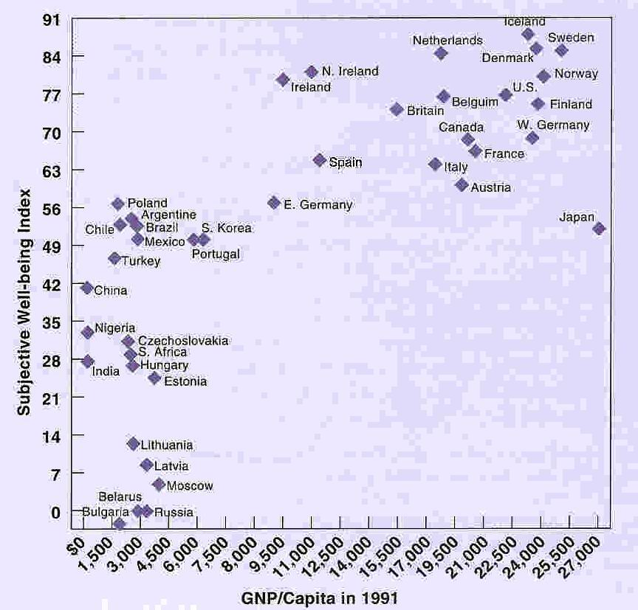
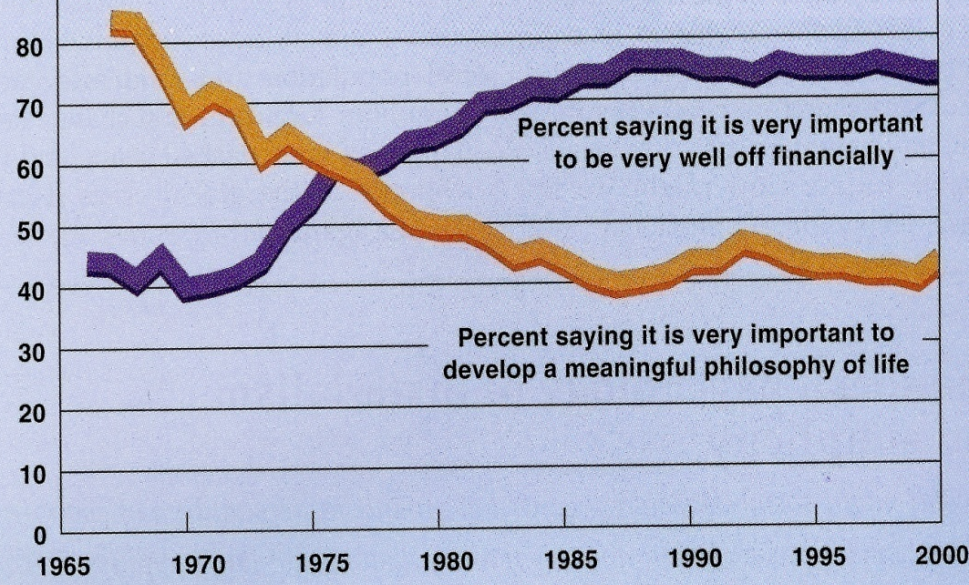
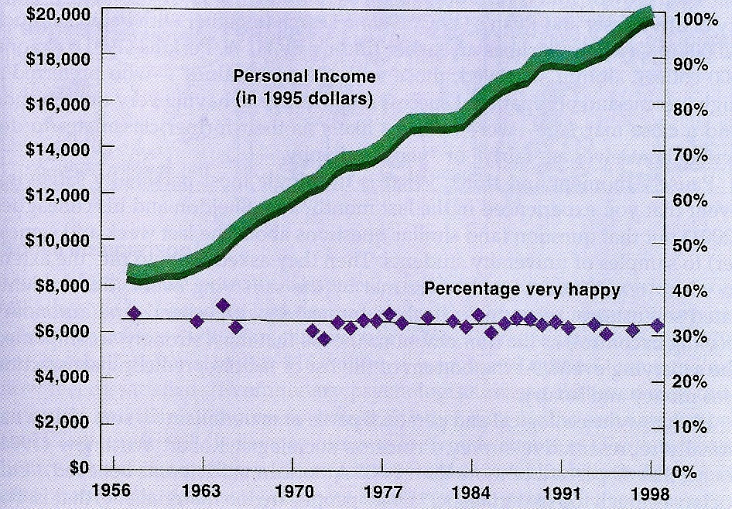
‘…all men are created equal, they are endowed by their Creator with certain unalienable rights, among these are Life, Liberty and the pursuit of Happiness’
Declaration of Independence
Jefferson 1776
Notes:
President Jefferson in 1776 considered the pursuit of happiness as the unalienable right of all humankind. Whether prosperity and consumption which are at the heart of this paper make people happier is a moot point.
But it is clear from happiness research that the relationship between happiness and per capita income is not closely matched (the Easterlin paradox) and across countries it is complex. It is well established, however, that people in rich countries are generally happier than those in poor countries.
Stevenson and Wolfers (2008) have re-assessed the Easterlin paradox using data from a broader array of countries. They established a clear positive link between average levels of well-being and income across countries. They found no evidence of a satiation point beyond which wealthier countries showed no further increases in subjective well-being.
An apparent inconsistency was in the United States where there has been no discernible increase in happiness over the past thirty-five years.

Slide 17
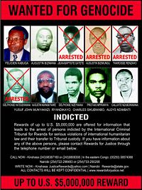
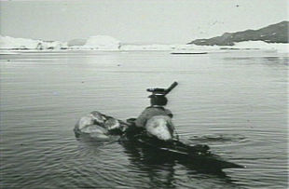
Moai of Easter Island
Rwandan genocide
Maya city of Tikal
Montana
Inuit and kayak
Notes:
Jared Diamond in “Collapse” has analysed how societies have dealt with crises arising from overconsumption. Some have succeeded while others have not.
In Easter Island it was largely because resources were overexploited; in the Yucatan peninsula there was population explosion and socio-political failure; in the medieval Viking colony on Greenland there was a failure to develop stable trading partnerships with Native Americans and adapt to their culture; in Rwanda it was mainly because of the impact of overpopulation.
In Diamond’s own state of Montana the attractive environment was sustained by Federal support through subsidies, while in the European Union the 15 rich states extended membership to include 12 poor states in Eastern Europe pledging to help them catch up.
Adaptation to principles of morality which encompass the idea of sustainable development has become a primary and urgent issue. Stewardship of shared resources is essential if we are to avoid the exploitation and overconsumption of the ecosystem services we take for granted – air, water, oceans, natural resources and reserves. There is growing recognition that mismanagement of resources can terminate cultures, what has become known as the ‘tragedy of the commons’ or the loss of what we share in common.
Where countries survived, individual rights were subjugated to group interests even though such rights were fought for so dearly in earlier generations.

Slide 18
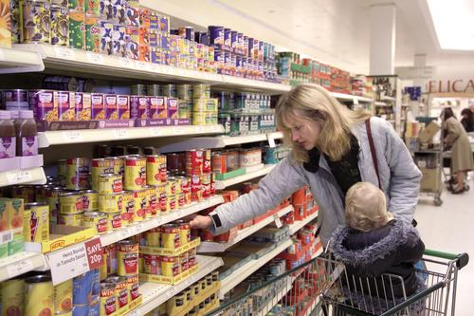
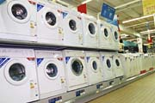
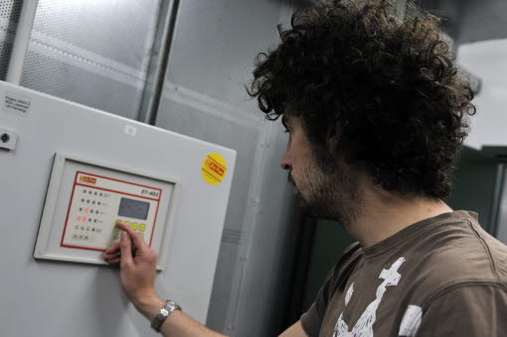
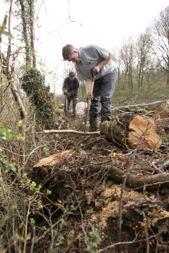
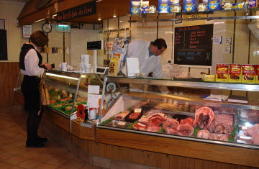
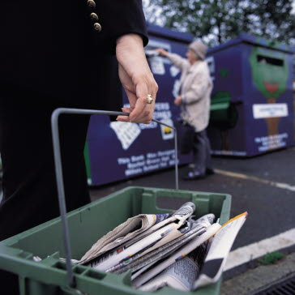
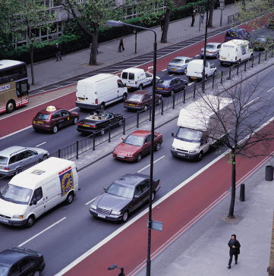
Influencing people’s behaviour is important for more sustainable lifestyles Centre of Expertise on Influencing Behaviour (DEFRA)
Notes:
Social reasoning and public discussion based on observation and experience play a key part in adaptation to more sustainable lifestyles.
A recent study in Canada showed that consumers made truly sustainable purchases in only a few product categories: appliances, household cleaners, food, and paper products. They were least sustainable in their purchases of technology products and personal care products. Activities that required a behavioural change and strong commitment to sustainability had a low level of participation.
A consumer’s life stage, level of education, and size of living space all contributed to sustainable purchasing behaviour. Consumers with the worst household sustainability scores were those with a university education, who owned their homes and lived in households with 2 or more persons.

Slide 19
We recognise there are many factors contributing to human behaviour Centre of Expertise on Influencing Behaviour, DEFRA, 2012
Infrastructure
Environmental
change
Experience
Norms
Culture
Attitudes
Social networks
Beliefs
Geography
Habits
Situational
factors
Influencing
human
behaviour
Behavioural
factors
Self-efficacy
Institutional
framework
Values
Identity
Access to capital
Social
learning
Awareness
Knowledge
Information
Altruism
Leadership
Perceptions
Notes:
Awareness of the significance of sustainability in today’s industrial societies and the need to understand in greater depth the many factors that influence human behaviour are essential to bring about behavioural change.
A recent study published by the UK government’s Department of Environment, Food and Rural Affairs (DEFRA) has developed The Sustainable Lifestyles Framework.
This Framework provides a tool to support organisations and communities to develop effective approaches to influence personal behaviour.
It outlines a set of key behaviours that constitute a sustainable lifestyle, identifies best practice to influence behaviour, and gives key insights on why some people act - all informed by a robust evidence base.
The DEFRA study recognises that there are thousands of behaviours which can contribute to sustainable living but that many people are not sure of the ‘right’ behaviours. ‘Indeed civil society and other organisations can find it difficult to identify the areas to focus on’.

Slide 20
No single solution - the 4Es model provides one tool to one single solution to ensure a mix of interventions (DEFRA)
Centre of Expertise on Influencing Behaviour
Make it easier to act
Remove barriers; build understanding; provide viable alternatives; educate/train/provide skills
Influencing behaviour is most effective when measures are combined from across these four broad categories of policy tools
Enable
Is the package enough to catalyse change?
Give the right signals INCENTIVES to encourage, and
DISINCENTIVES to ensure your target audience responds
Get people involved Work with trusted intermediaries; use networks; mobilise population groups
Encourage
Engage
Exemplify
Demonstrate shared responsibility Lead by example; consistency in policies
Notes:
Here is a specific example which aims to tackle the problem of waste and changing people’s behaviour. There is no single solution but a four-fold model (4E model) has been used to shape activity. This model identifies a best practice principle for delivering change.
From DEFRA’s comprehensive study it is expected that other organisations will have the confidence and capacity to shape activity based on evidence from a set of nine headline and, within these, 30 key behaviours relating to sustainability impacts (e.g. CO₂, water, biodiversity and wellbeing).
Lacking from this framework is consideration of the importance of values which are informed by religious and humanitarian beliefs. These universal values map closely on to sustainable consumption and production and inform the lives of millions of people worldwide. Because of their pervasiveness they should be incorporated into decision-making processes as they encourage behavioural change towards the preservation and conservation of what is needful for the success of this and future generations.

Slide 21
European Science Academies
An estimated 70-80% of new legislation of EU member states stem directly or indirectly from Brussels
EASAC enables the National Science Academies of Europe to fulfil their task of giving relevant, authoritative and timely science-based advice to their governments and societies by being present in Brussels.

Slide 22
What is EASAC?
Collective voice of the National Academies of Science of the EU Member states
Instrument of independent scientific advice for policy-makers in the European institutions
National Science Academies:
networks of scientific excellence
task of authoritative science-based policy advice

Slide 23
EASAC‘s Membership
24 National Academies of Science of EU Member States
(not Malta, Luxemburg and Cyprus)
Switzerland and Norway also represented
Academia Europaea, the pan-European Academy of Science,
ALLEA, the association of all European academies,
FEAM, Federation European Academies of Medicine, (observer)

Slide 24
Some EASAC Reports and Statements
Transforming the EU‘s Electricity Supply 2009
Realising European potential in Synthetic Biology 2010
Groundwater situation in the Southern EU 2010
Climate Change and Infectious Disease in Europe 2010
Concentrated solar power 2011
Impact of Engineered Nanomaterials on Health
Joint report with JRC, 2011
Infectious Diseases and the Future: Policies for Europe 2011
EU Public Health & Innovation Policy for Infectious Disease
2011
Synthetic Biology: An Introduction 2011

Slide 25
Current EASAC projects
Plant Genetic Resources for Food and Agriculture
Direct-to-Consumer Genetic Testing
Extreme weather events
Sustainable Biofuels
Carbon Capture and Storage
The need for new anti-microbial Drugs
GM crops
Marine Sustainability

Slide 26
Horizon 2020 (‘FP8’)
€31.7bn is earmarked for projects across 6 themes
Health, demographic change and wellbeing
Food security, sustainable agriculture, marine and maritime research, and the bioeconomy
Secure, clean and efficient energy
Smart, green and integrated transport
Climate action, resource efficiency and raw materials
Inclusive, innovative and secure societies

Slide 27
Adaptation towards sustainable consumption and production in Europe
Low growth has become a feature of several developed country economies in the first decade of the 21st century
Sustainable consumption and production is a relevant paradigm in which science technology and innovation (STI) have a major role to play
STI does not hold all the answers as the aspiration of a ‘plenitude of everything for everyone’ will require behavioural change and a subjugation to group interests
Notes:
To summarise:
Low growth has become a feature of several developed country economies in the first decade of the 21st century
Sustainable consumption and production is a relevant paradigm in which science technology and innovation (STI) have a major role to play
STI does not hold all the answers as economic growth at any price has to be ‘subjugated to group interests’.

Slide 29
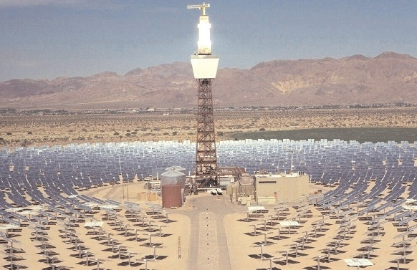
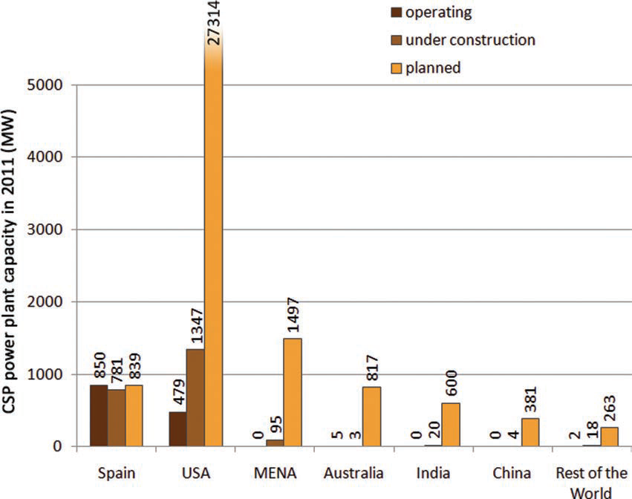
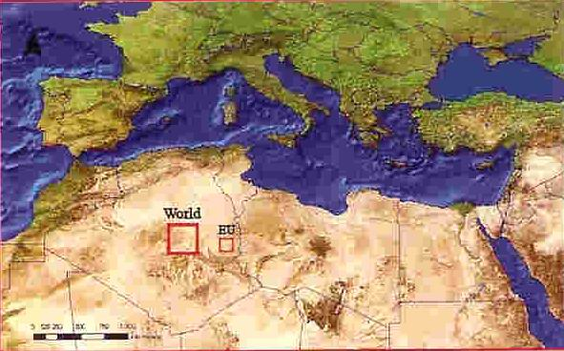
Concentrated solar power (CSP)
Plants that are operating,
under construction,
or planned
w.trec-uk.org.uk
http://www.easac.eu/fileadmin/Reports/Easac_CSP_Web-Final.pdf
Notes:
Renewable energy sources are anticipated to play a major role in achieving these longer-term targets, although as yet the relative contributions from individual technologies such as CSP have not been established
Concentrated solar power (CSP) systems use mirrors and tracking systems to focus a large area of sunlight onto a small area. The concentrated light is then used as a heat source for a conventional power plant or is concentrated onto photovoltaic surfaces.
A major challenge will be to move towards, and in time to achieve, cost parity of CSP and fossil-fired generation. Around half of the anticipated reductions in CSP generating costs are expected to come from technology developments, and the other half from economies of scale and volume production
From these brief examples we can see how science and technology can contribute to ways that help us towards a paradigm of more sustainable consumption and production, but ‘technological fixes’ are not enough. We will need to also use economic, fiscal and behavioural change instruments if we are to avoid repeating the mistakes of the past by adapting to universal principles of morality. This has become a pressing issue in Europe with its experience of low growth and high unemployment and we will examine a specific example from the UK.
Growth comes in different forms. Physical growth occurs in the amount of energy and matter that can be mobilized by the economy; economic growth in money flows, incomes, expenditure and value added; and growth in human welfare which is dependent on sustaining environmental functions, incomes, security, safety, leisure and relationships. What are the value systems that underpin the economies of the more developed nations now that they are experiencing a near ‘de-growth’ situation? Is there are causal relationship to be elucidated? Or will a change in behaviour enable us to choose our own destiny?

