Slide 1


Nuke or Else?
Dana Drábová
State Office for Nuclear Safety, Prague,
Czech Republic

Slide 2
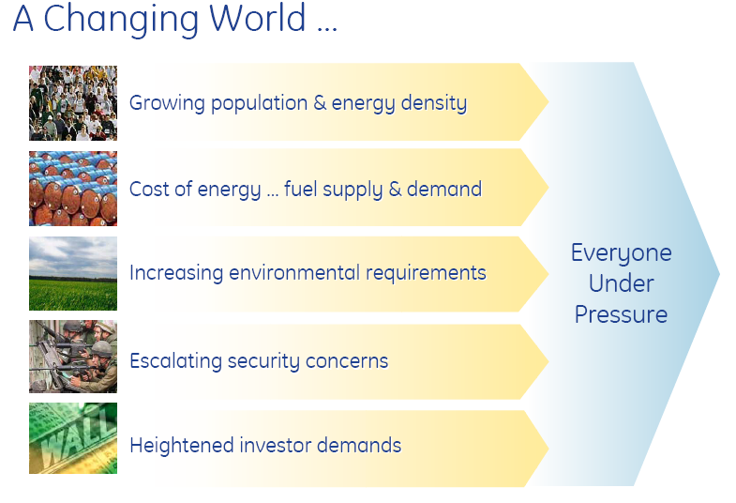

Slide 3
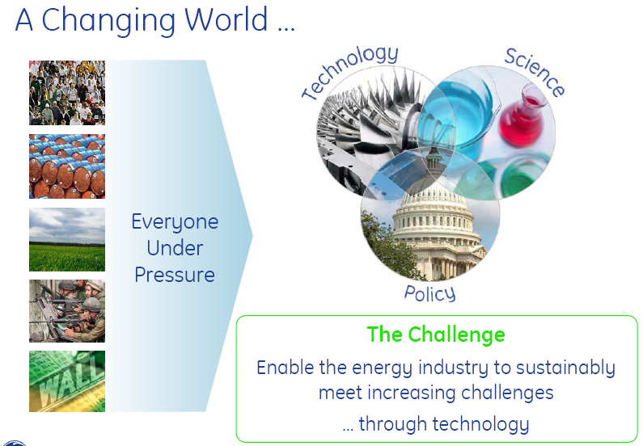

Slide 4
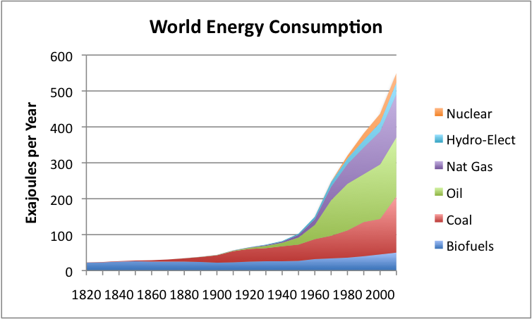

Slide 5
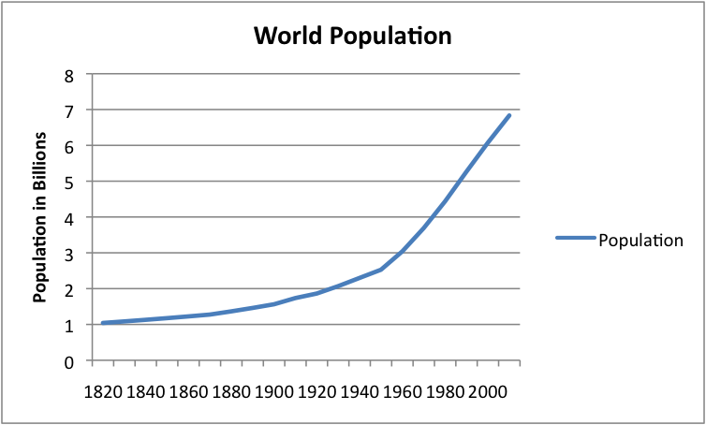

Slide 6
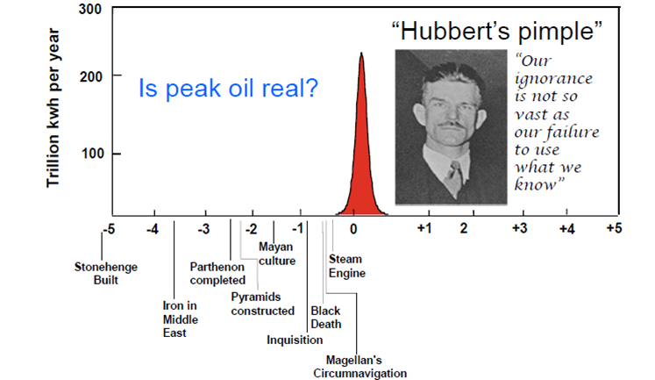

Slide 8
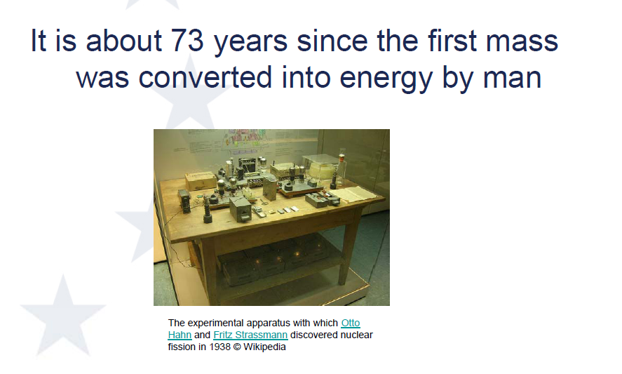

Slide 9
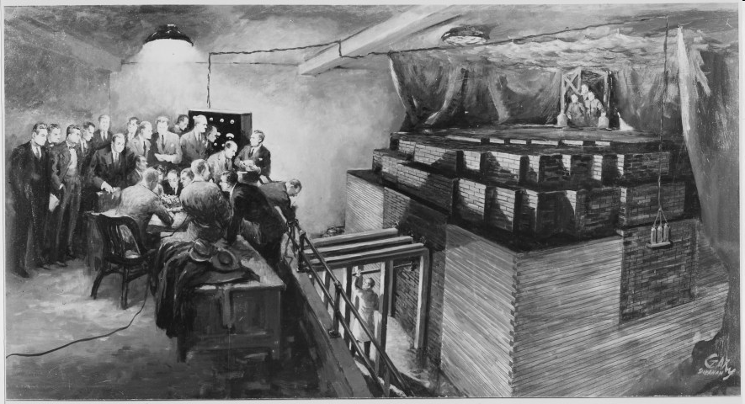
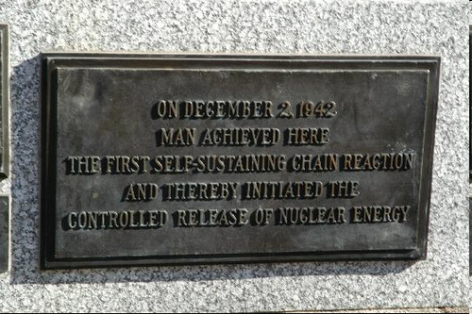
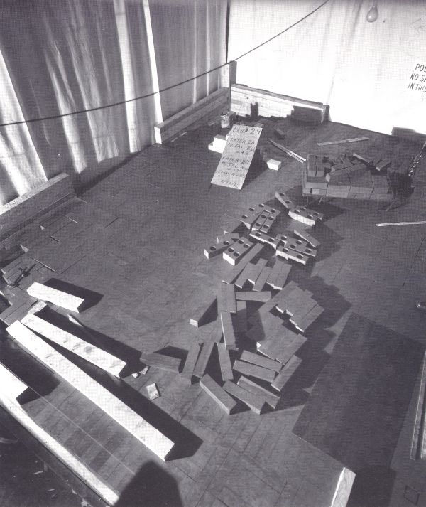
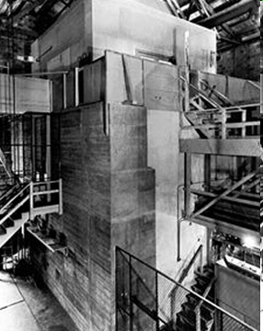
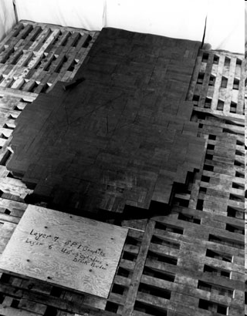

Slide 10
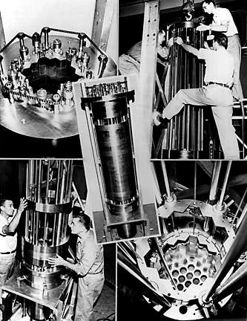
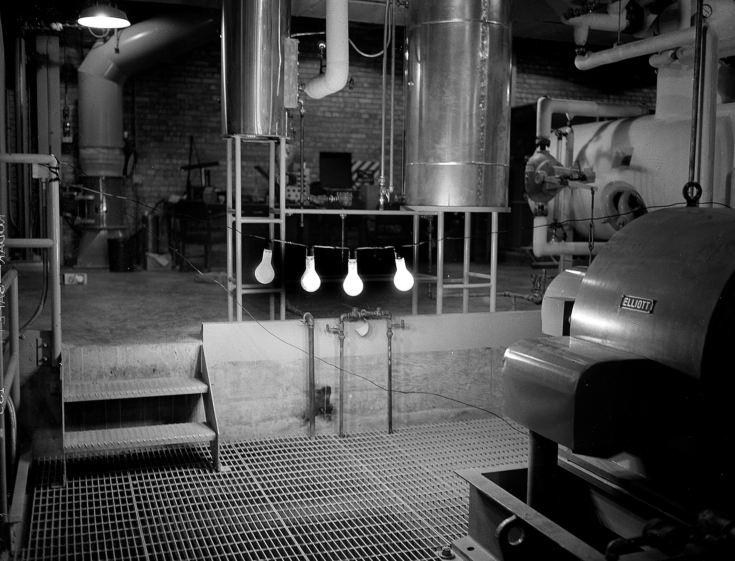
Experimental Breeder Reactor I (1951)

Slide 11
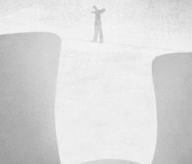
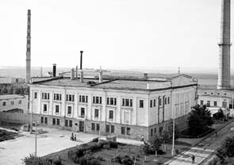
Obninsk, 1954

Slide 12
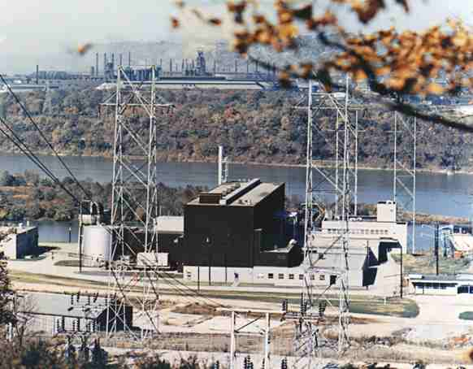
Shippingport, PA, 1957

Slide 13
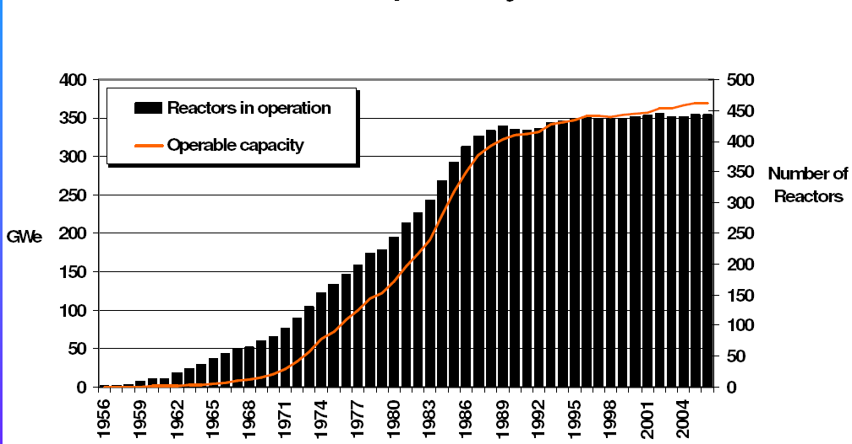
Number of Commissioned Units

Slide 14
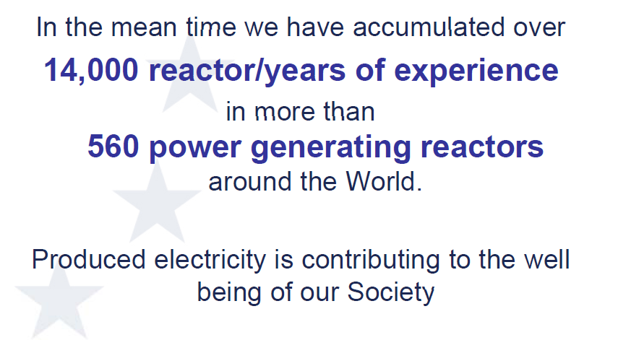

Slide 15
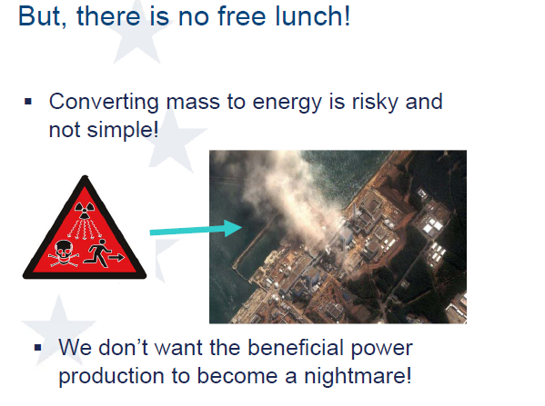

Slide 16
Nuclear energy debate
The use of nuclear energy is being extensively scrutinised once again in light of present debate on its role in sustainable development and on global security problems. The primary objective is to allow mankind to maximise the benefits and minimise the risks.
The key words of this debate are safety, non-proliferation, security and technical co-operation in the peaceful uses of nuclear technology.
To prepare for the future there is need for new and fully integrated approach to all infrastructure areas including also regulation.

Slide 17
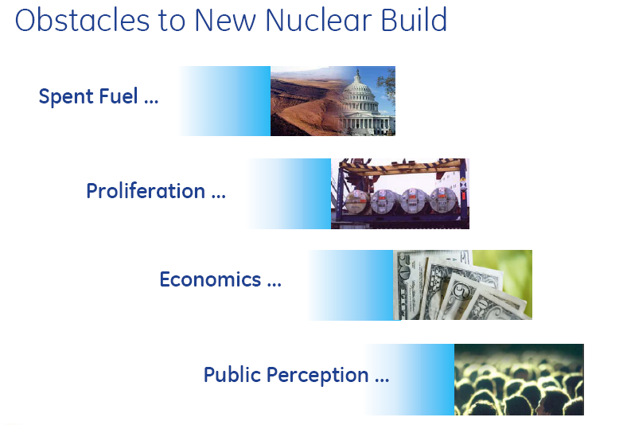

Slide 18
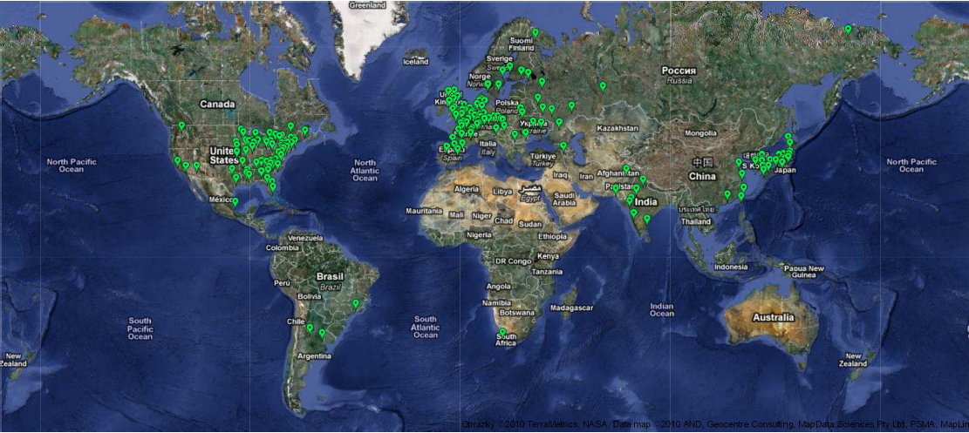
Units in operation

Slide 19
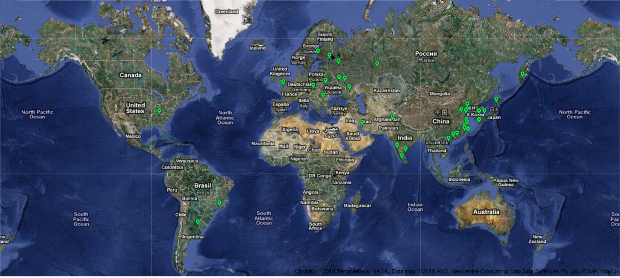
Units under construction

Slide 20
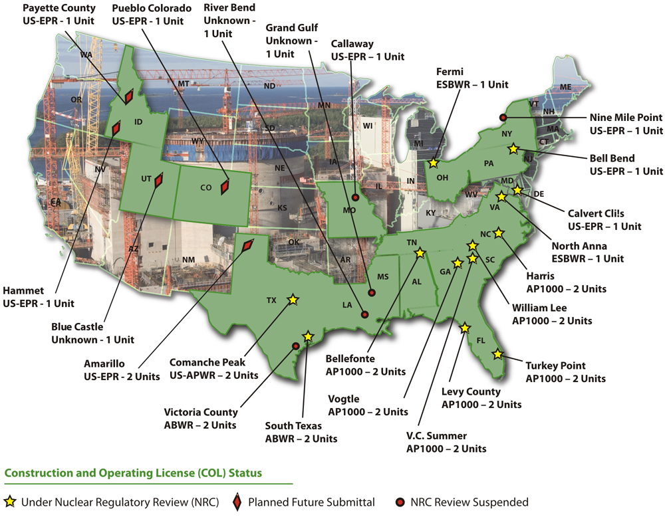

Slide 21
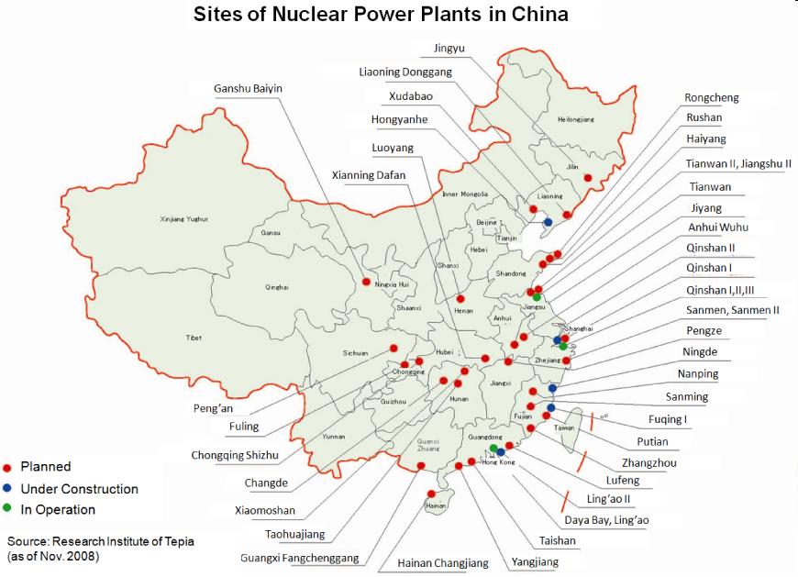
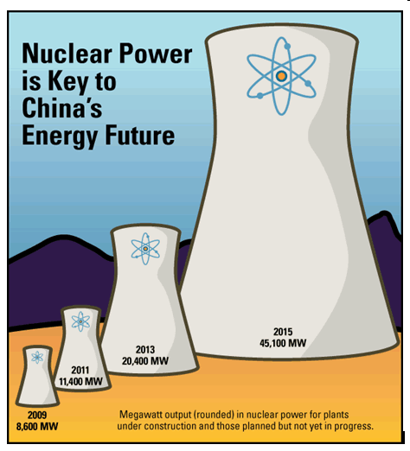

Slide 22
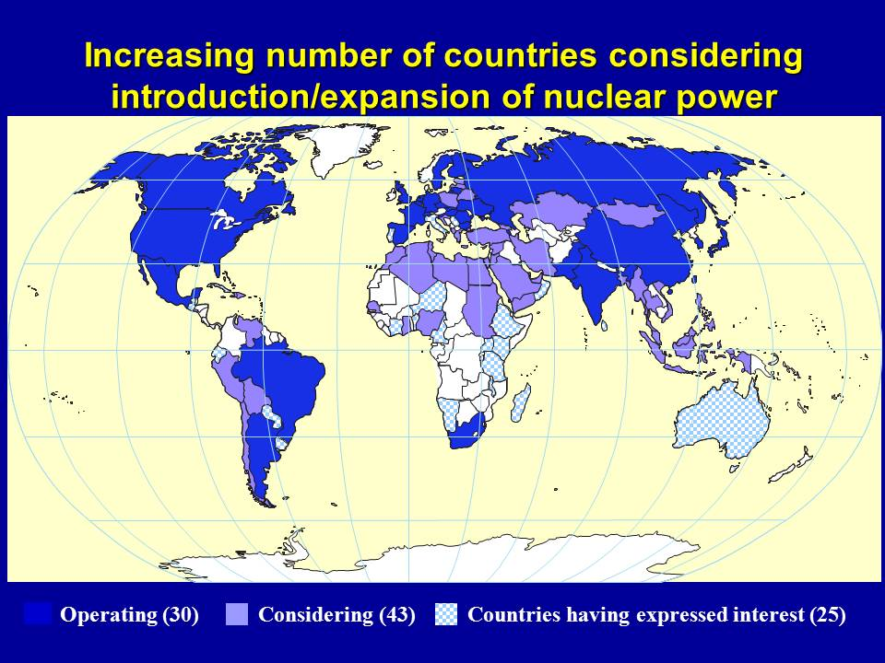

Slide 23
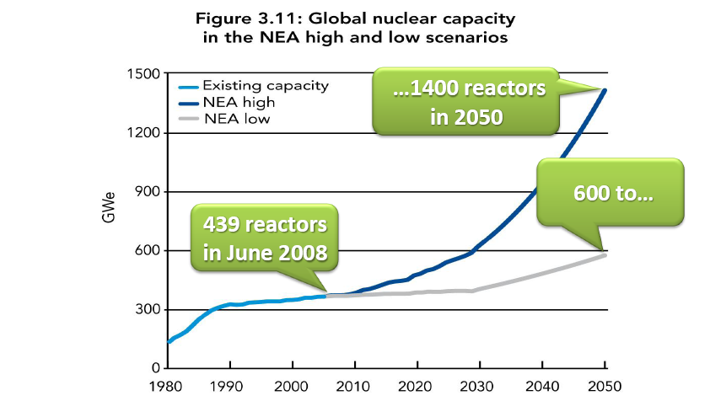
Nuclear renaissance?

Slide 24
Nuclear renaissance?

Slide 25
Nuclear Power can contribute to sustainable development
Electricity (16% today)
Transport sector: hydrogen production
Water desalination:
  2,3 B people in water-stressed areas
  1,7 B people in water-scarce areas
Environmental goals:
  2-6 grams of C per kWh,
  600 Mt of C annually.
Resource base: U and Th,
Advanced in internalizing external costs: safety, waste disposal, decommissioning are in price of electricity.

Slide 26
Drivers for rising expectations for nuclear power growth
Growing energy needs;
Security of energy supply;
Environmental concerns and constraints;
Rising and volatile prices of fossil fuels;
Improved relative economic competitiveness of nuclear power;
Nuclear power’s increasing experience and good performance;
Interest in advanced applications of nuclear energy

Slide 27
Policy Implications for Nuclear Renaissance
Continued diligence in achieving safety and reliability of nuclear plants;
Improving economic competitiveness;
Financing nuclear is a major challenge
Achieving and retaining public confidence in nuclear power;
Retaining and developing the necessary workforce competences;
Continuing successful management of spent fuel and radioactive waste;
Demonstrating the successful ultimate disposal of spent fuel and high level waste;

Slide 28
Policy Implications for Nuclear Renaissance
Management and acceptance of the transport of nuclear fuel;
Maintaining confidence in nuclear non-proliferation and nuclear security;
Establishing acceptable infrastructure in countries introducing nuclear power;
Achieving proven reactor designs that are appropriate to specific countries;
Achieving, for the long term, effective and sustainable use of resources.
Enhance public dialogue to inform stakeholders about the role of nuclear in energy strategy
Stable government policies on nuclear is key

Slide 29
Sustainable nuclear energy
Availability, Affordability, Acceptability
Safety
Security
Safeguards
To prepare for the future there is a need for new and fully integrated approach to all infrastructure areas, including also regulation.

Slide 30
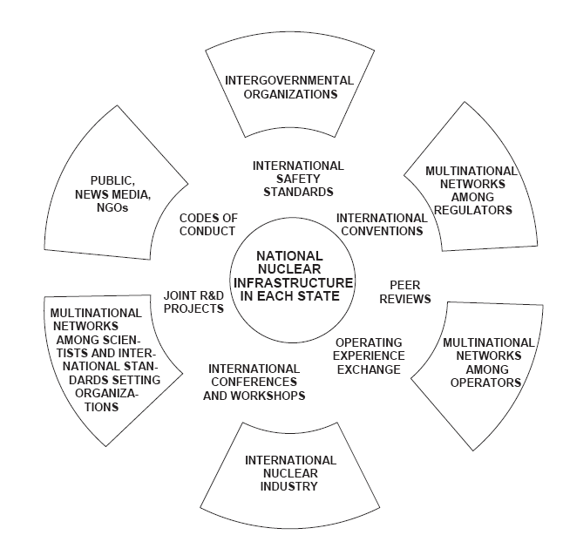
Global nuclear safety scene

Slide 31
The Train is Leaving the Station
Am I on it?
Do I know where it is going?
Do I know what to do once I am on the train?
Do I know if everybody on the train knows what they should do?
Do I have the plan, the tools, the resources I will need to get it to its destination?
Do I and everyone else know what to expect during the trip?
Do I know what to do when it gets to its final destination?

